Slide 1
WebexCC-New Digital Channels Configuration Quick Start Guide
Partner Success
August 2021

Slide 2
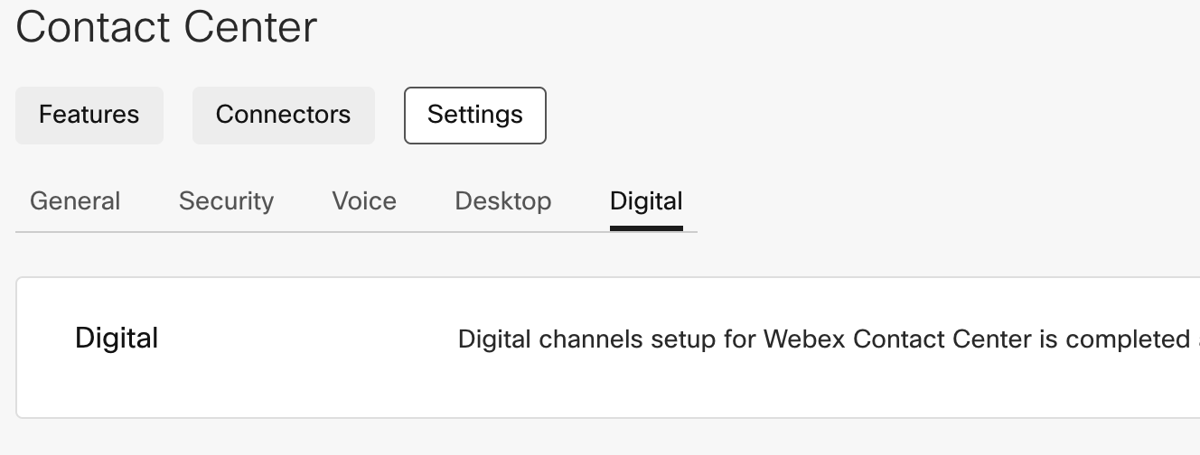
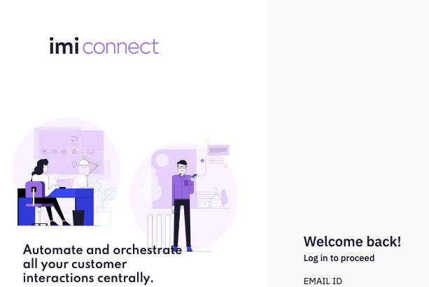
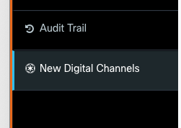
New Digital Channels Pre-requisites
Webex Contact Center (WebexCC) Gold Tenant Completed
IMI Tenant Setup and Integrated with the Gold Tenant
Digital Channels Visible on Control Hub
3. Access to IMI Connect:
The Connect URL is usually in the format: https://<Goldtenant>.imiconnect.io
4. Access to IMI Engage:
This is accessed using New Digital Channels Visible on Portal

Slide 3
Before you Begin
1 | Steps in this guide are based on and for configuring a new digital channels in the production environment
2 | Users of this guide already have administrator access to a production tenant (WxCC & IMI)
3 | Users of this guide already have Email ID for email contact routing
4 | Users of this guide already have a Facebook page which can be integrated with the tenant
5 | Users of this guide already have a Google CCAI account that can be configured in the tenant
6 | Tenant has Feature Flags enabled for New Digital Channels (IMI)
7 | Users of this guide are aware of their Engage/Connect instance URLs and logins

Slide 4
Index
Quick Links
Module-1 | IMI Interfaces/Terminology
Module-2 | User Onboarding/Sync
Module-3 | Standard Workflows
Module-4 | Facebook
Module-5 | SMS
Module-6 | Chat
Module-7 | Email
Module-8 | Templates
Module-9 | Workflow Debugging
Control Hub | https://admin.webex.com
Portal | https://portal.wxcc-us1.cisco.com
Agent Desktop | https://desktop.wxcc-us1.cisco.com/
Engage | https://___<your site>____.imiengage.io (Cross launch from WxCC portal)
Connect | https://___<your site>____.imiconnect.io/

Slide 5
Module 1
New Digital Channels - Interfaces

Slide 6
Objective
Understand the architectural overview of WxCC integration with the new digital
channels (IMI) and commonly used IMI terminologies
Outcome
Understand IMI interfaces, basic
Knowledge of the integration
Access to resources for deep dive

Slide 7
WebexCC – IMI Interfaces Overview
IMI Mobile
Digital
Media
Manager
WebexCC
Core Engine
WebexCC Data Platform
Assets
IMI Connect
Configuration,
Flows,
Debugging
Flow
WebexCC APIs
Admins
Digital Channels
Agents
WebexCC Desktop
Media
IMI Engage
IMI Desktop
IMI web component
IMI Desktop
Agent Desktop, handling media, conversations
Portal
Webex Control Hub

Slide 8
Definitions
Integration with Webex Contact Center
IMI has 2 applications namely Engage & Connect
Inbound digital channels land on IMI Engage which is notified to IMI Connect which will trigger a flow
Based on the ingress trigger (an incoming digital contact in this case), a workflow is executed
Internally the workflow creates a conversation in IMI & a task in WebexCC.
The task is queued in WebexCC
IMI integration with WebexCC is through a new microservice called ‘Digital Media Manager’ . Everything else on WebexCC remains same (same routing engine, Reporting, etc.)
The API that will come out of Digital MM will be in future publicly exposed for other channel providers to integrate with WebexCC routing engine. This interface is called Task APIs
The existing media view desktop component for native digital channels will be replaced by a new IMI web component in the same layout
Term | Description
IMI Connect | Assets, Flows are configured. Flows can be debugged. Admin interface. Users need to be created manually
IMI Engage | IMI desktop. Not applicable for WxCC integration. Users in WxCC are sync’d to Engage. No manual intervention needed
Assets | This is the configuration that’s associated with channels like FBM, SMS, Chat, Email
Flow Builder/Flow | What Flow Control is for voice, IMI flow/flow builder is for the new digital channels
Templates | Standard workflows will be created as templates that can be used for quick configuration of flows.
Conversation | Task for WebexCC, conversation to IMI
Service | A workspace. Has a collection of assets and flows

Slide 9
Module 2
User Onboarding

Slide 10
Objective
You will be able to complete configurations related to user onboarding required in IMI Connect application.
Pre-Requisites
Outcome
Pre-Requisites
Users are already onboarded in WebexCC Control Hub
Org has IMI Entitlements and Feature Flags enabled
Working knowledge of WebexCC Control Hub
Outcome
Users are successfully onboarded in IMI Connect

Slide 11
User Management Overview:
Onboarding experience on WebExCC remains same. Details for WebExCC user onboarding here: https://wxcctechsummit.github.io/wxcclabguides/TechSummitRoW_2021/CH.html
Only if agents are sync’d to IMI Engage application, would they be able to successfully accept contacts in WebExCC desktop
This is taken care with the integration
All relevant users will be sync’d. No manual intervention needed
Can be cross launched from WebExCC (as a customer admin ONLY)
IMI Connect does NOT have SSO or CI integration. Users need to be created manually
ONLY administrators to be added here
Once a user mail ID is added in a Connect instance, it cannot be added to another Connect instance. New mail ID required
Engage
All Administrators, Supervisors, Premium Agents are sync’d. No manual effort needed
WebEx CI/CH
Connect
No Sync available. ONLY administrators needs to be manually added here

Slide 12
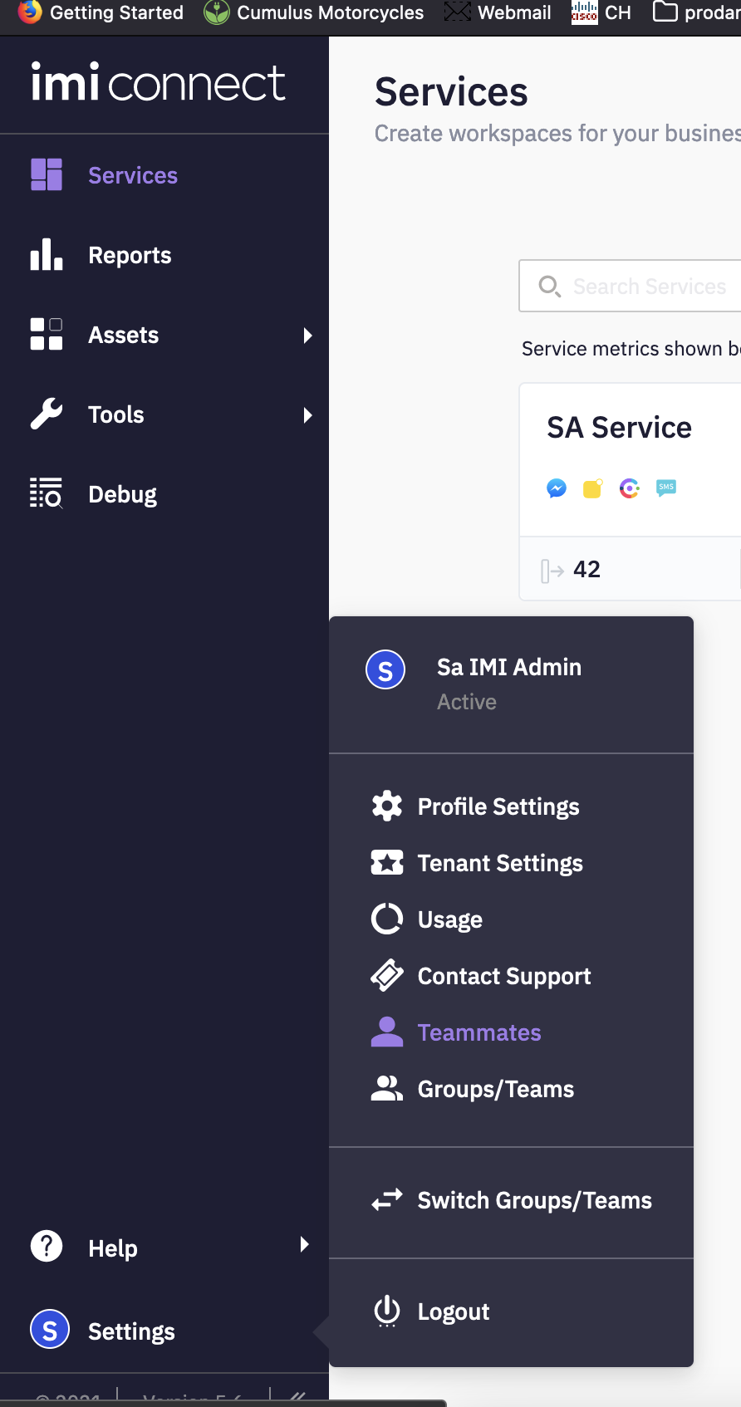
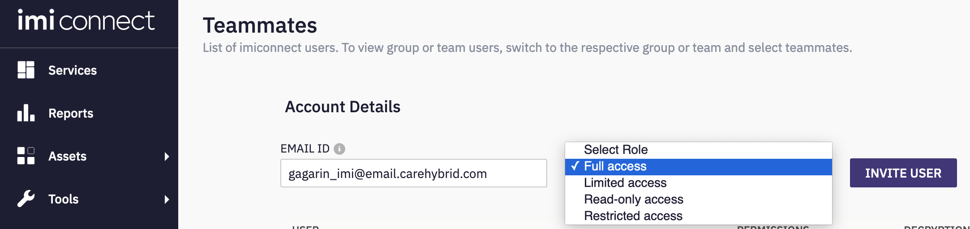


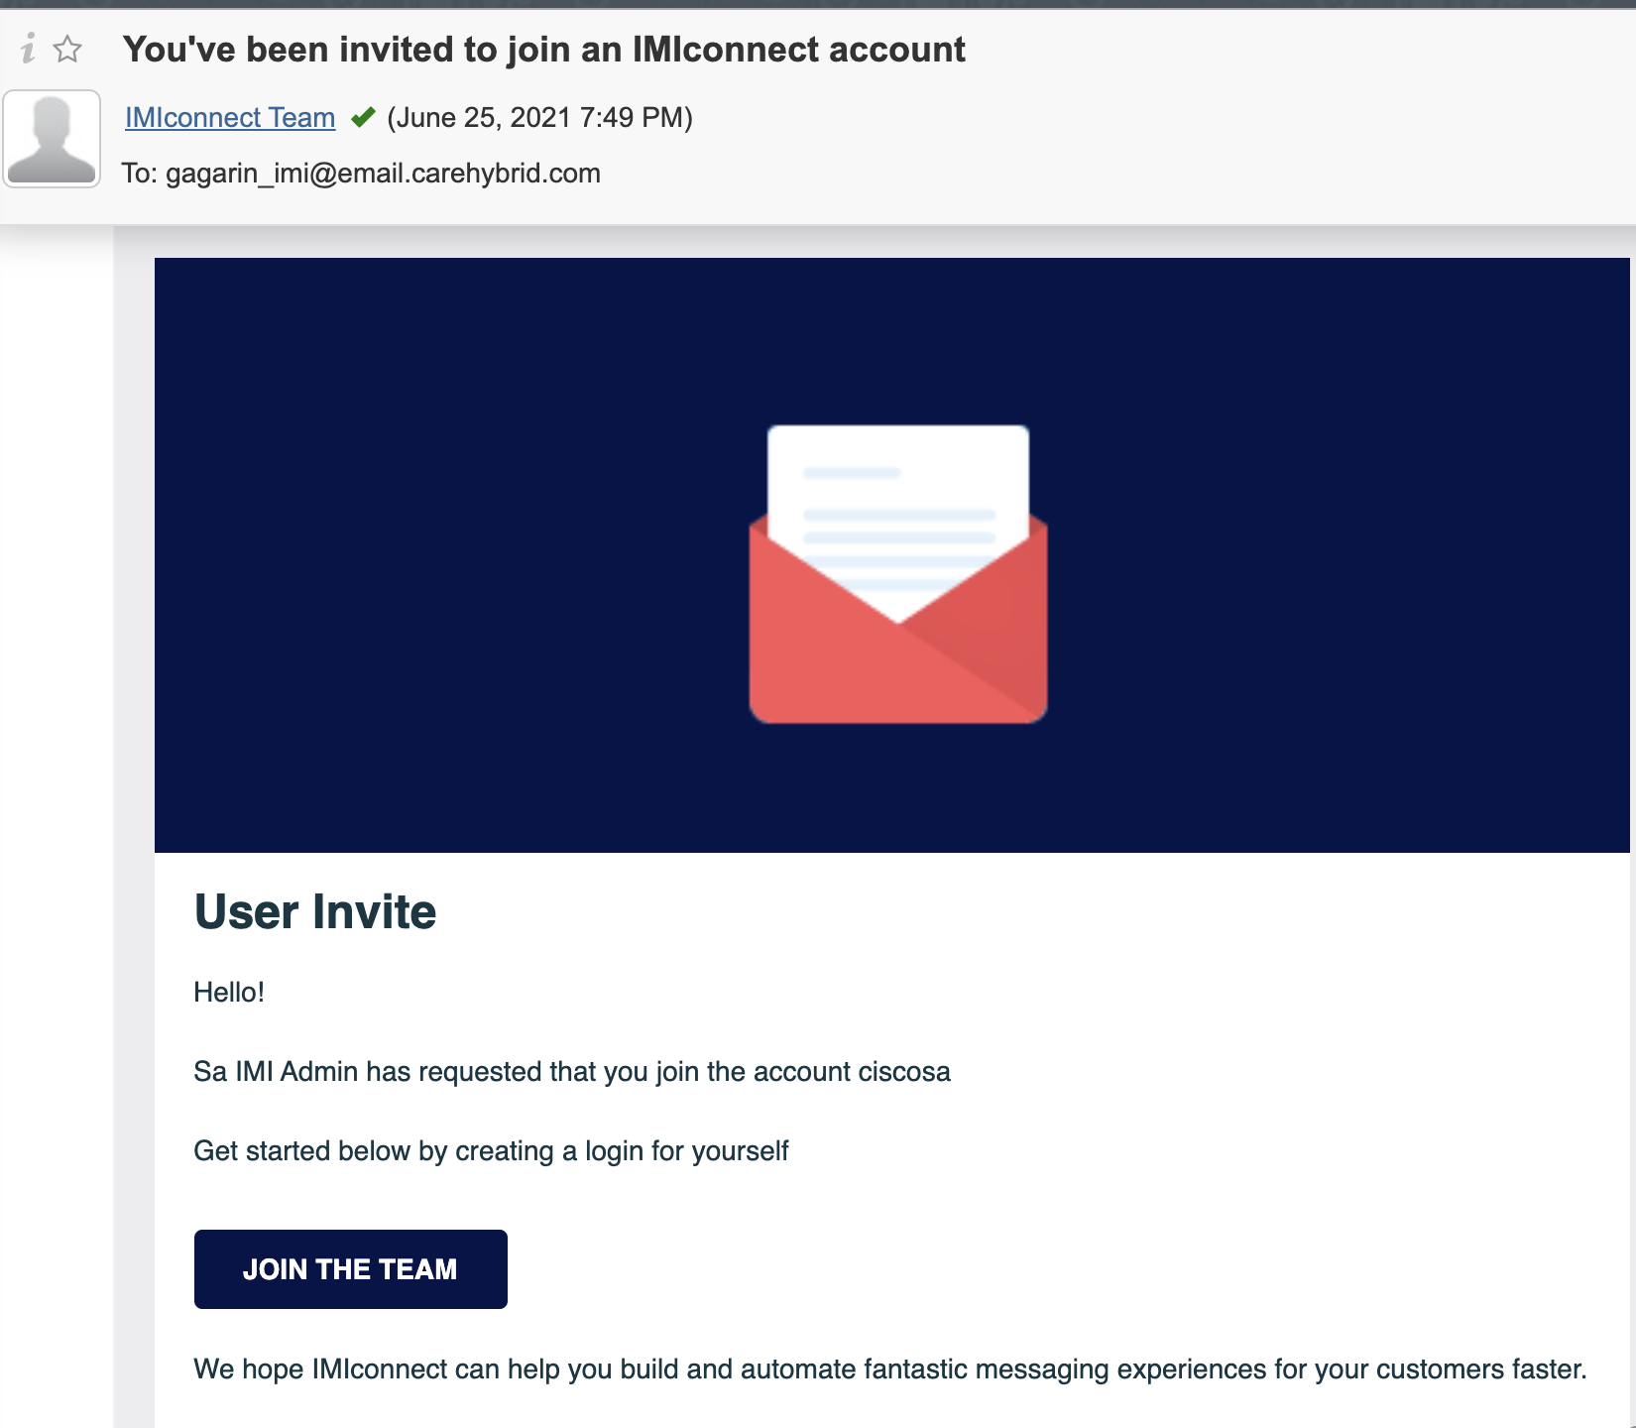

Create Users in Connect
Add a valid email ID, select required roles and invite user
Follow the steps in the email received to activate user in Connect
Login to Connect URL
Go to Settings > Teammates

Slide 13
Module 3
Standard Workflows

Slide 14
Objective
To understand various flows required for new digital channels to work
Pre-Requisites
Outcomes
Assumptions
Working knowledge of WebexCC 2.0 native digital channels
Access to IMI tenants
Access to flows
Outcome
Various Types of flows
How each of the flows are used
Accessing the flows
Uploading the flows to tenants
Making the flows Live

Slide 15
Workflows Overview
Channel specific inbound workflows needs to be created per channel/trigger
Routed workflow is 1 per instance and gets triggered when an agent clicks ‘Accept’ button in WxCC desktop
Modified workflow is 1 per instance and gets triggered when an agent attempts transfer/conference in WxCC desktop
Closed workflow is 1 per instance and is triggered when agent clicks on ‘End’ button in WebexCC desktop
Routed, Modified, Closed workflows are readily available and can be uploaded to the tenant and then updated with the tenant specific configuration
FBM
SMS
Email
Chat
Inbound Workflow
Inbound Workflow
Inbound Workflow
Inbound Workflow
Routed Workflow
Modified Workflow
Closed Workflow

Slide 16
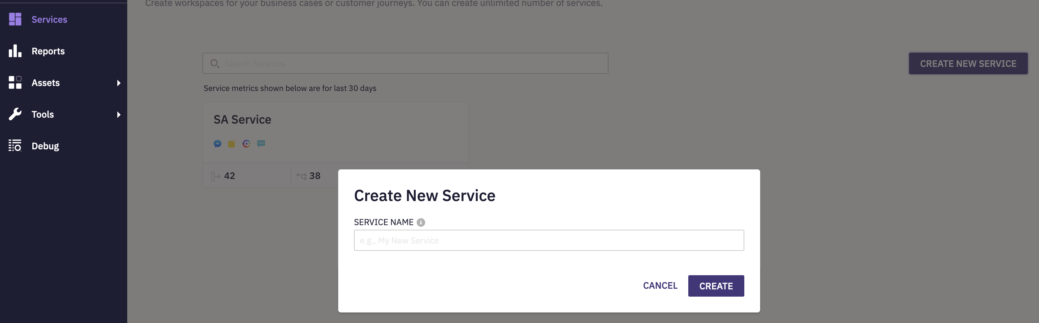
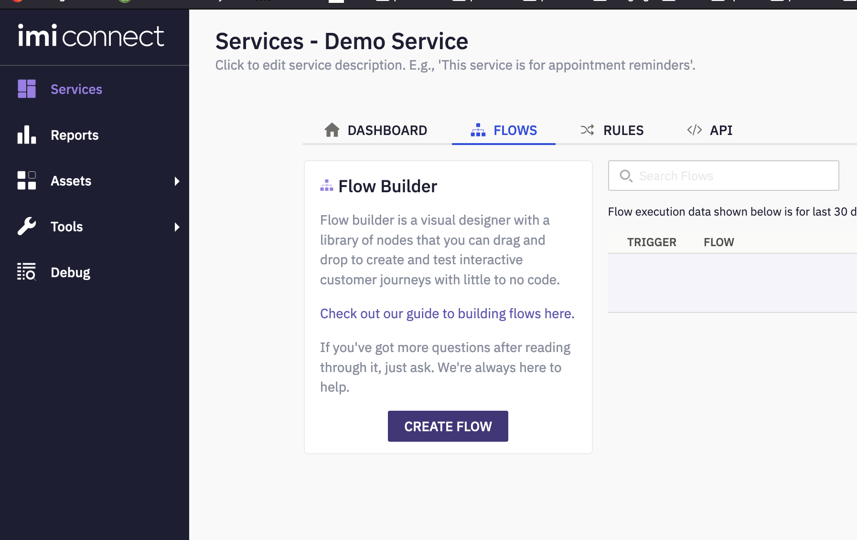
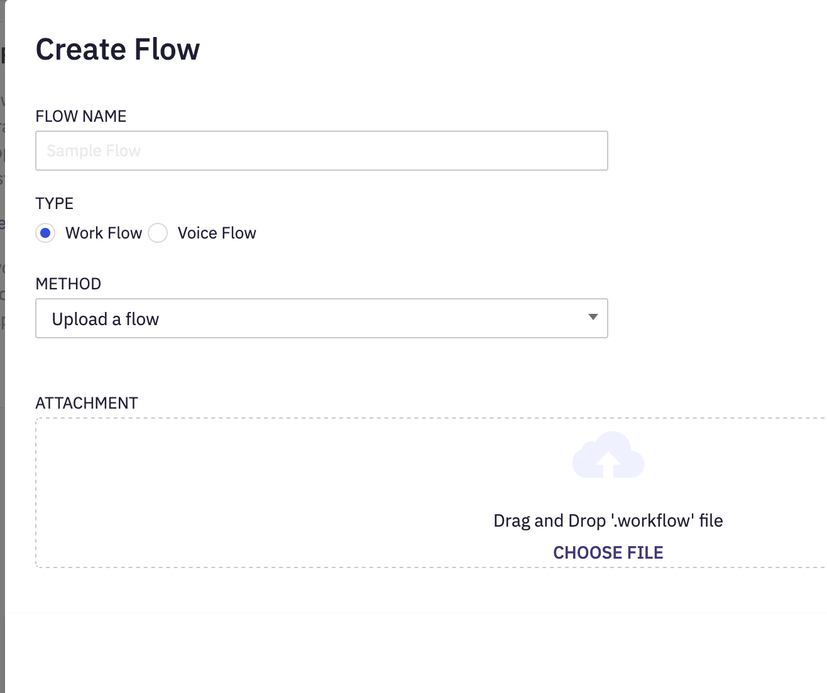
Flow Upload
Login to Connect URL
Go to Services > Create New Service
Go to Flows > Create Flow
Enter Flow Name
Select Type as ‘WorkFlow’
Select Method as ‘Upload a Flow’
Upload all 3 flows provided in the below link :
https://github.com/CiscoDevNet/webexcc-digital-channels

Slide 17
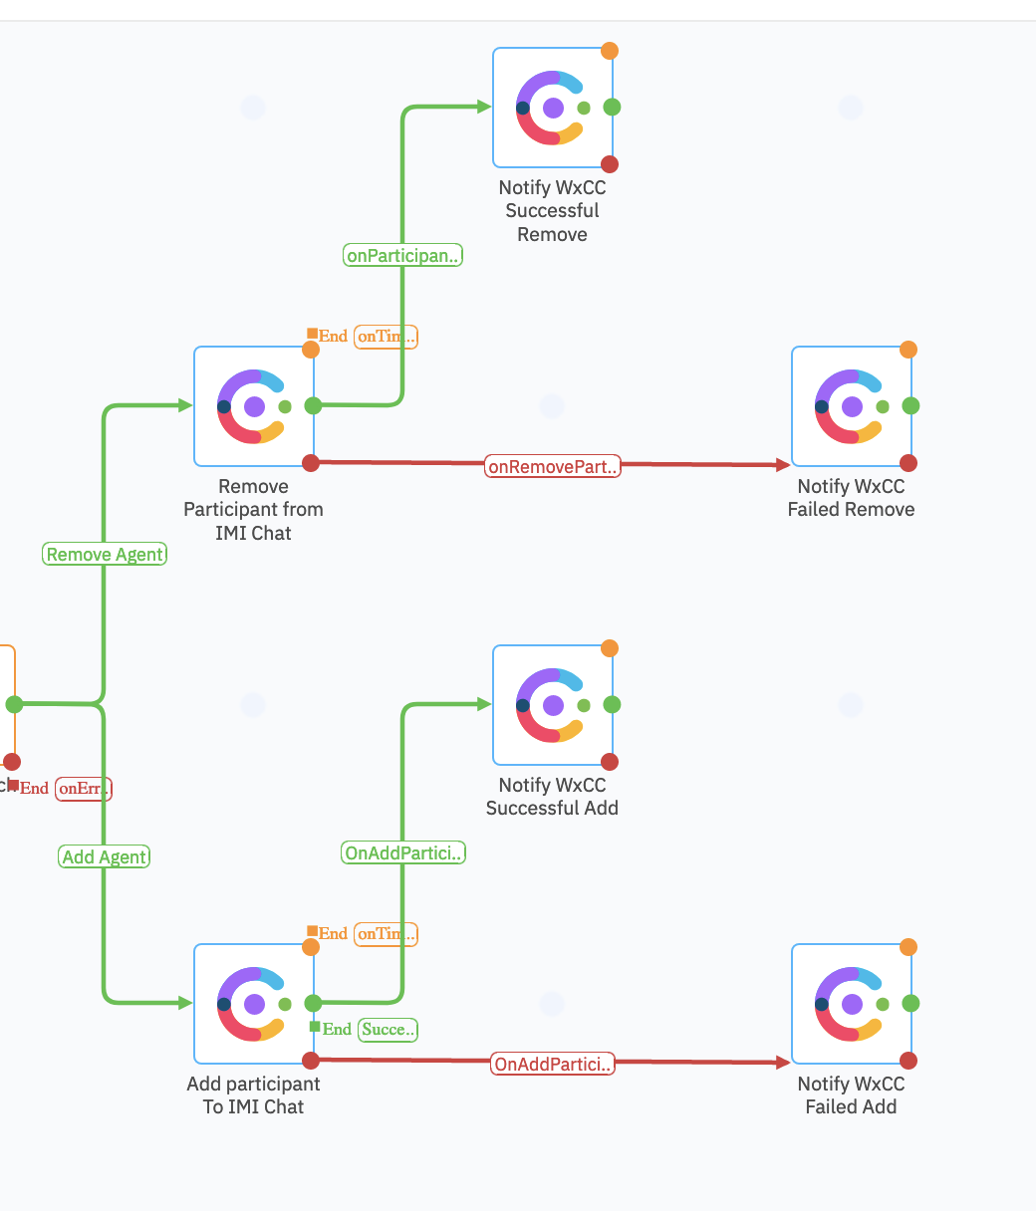
Modified Flow
In “Add Participant” to IMI chat, “Remove Participant” from IMI chat add Engage authorization
In other Notify WebExCC nodes, add WebExCC Authorization
Engage Authorization
Client ID | _______your Client ID shared by the PSAM team____
Client Secret | _______your Client Secret shared by the PSAM team____
Domain | api-us-site-1.imiengage.io
WebexCC Authorization
While adding WebexCC auth, login with the WebexCC tenant admin creds.
The credentials above will change based on the IMI tenant and the WxCC environment.
The above need to be edited for your tenant

Slide 18
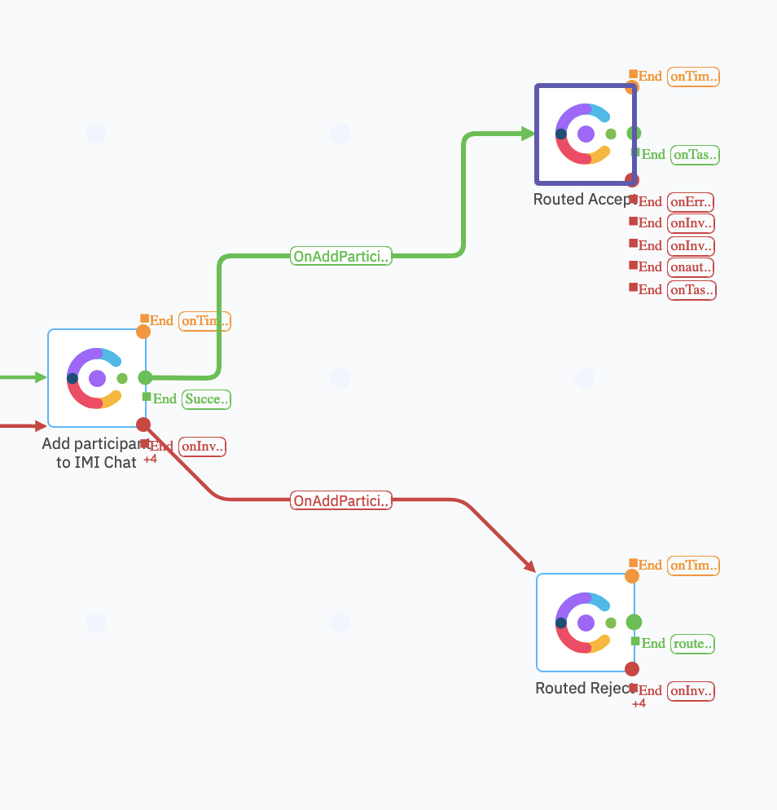
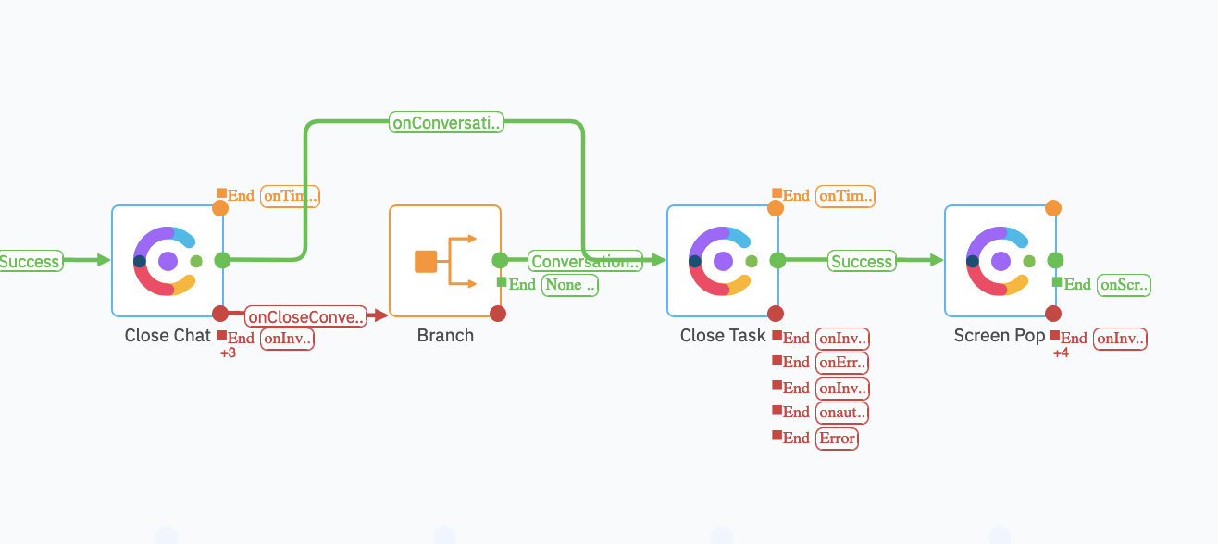
Routed Flow
Closed Flow
In ‘Close Chat’ add Engage Authorization
In ‘Close Task’ add WebexCC Authorization
In ‘Add Participant to IMI chat’ add Engage Authorization
In Routed Accept and Routed Reject add WebexCC Authorization

Slide 19
Module 4
Facebook Integration

Slide 20
Objective
You will be able configure and demo Facebook channel integration with the new Digital Channels
Pre-Requisites
Outcome
Pre-Requisites
WebExCC Agents are created and associated with teams
Have a FB page created, and logins are available
Service is created in IMI
All the standard flows are uploaded in the tenant
Outcome
Successfully integrate FB page to IMI
Initiate a contact in FB page and route successfully to WebExCC Agent

Slide 21
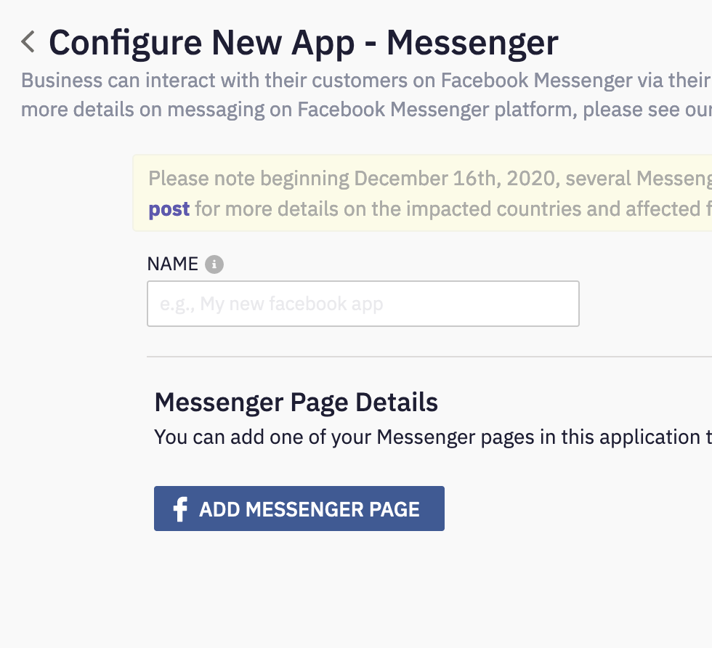
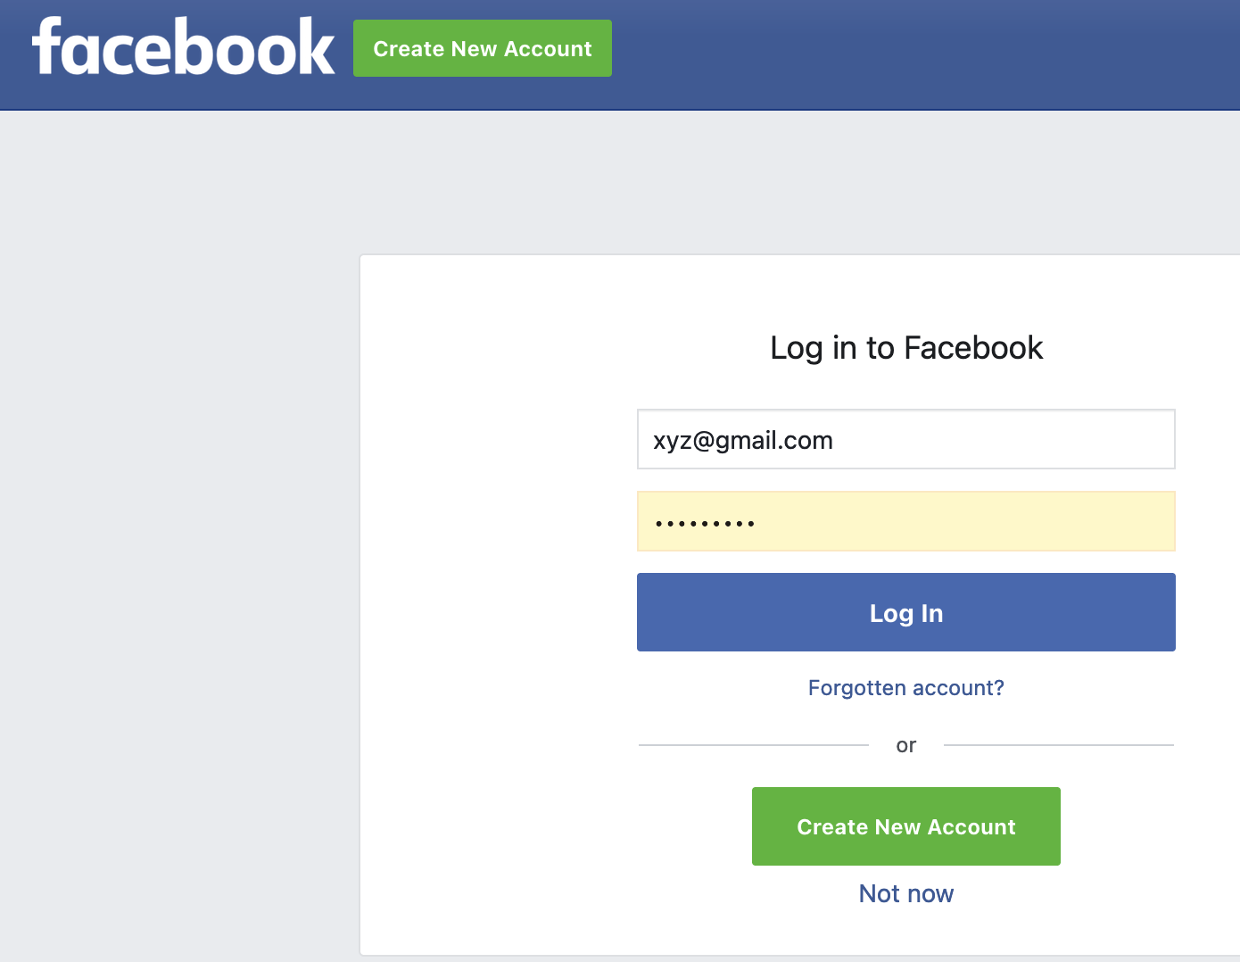
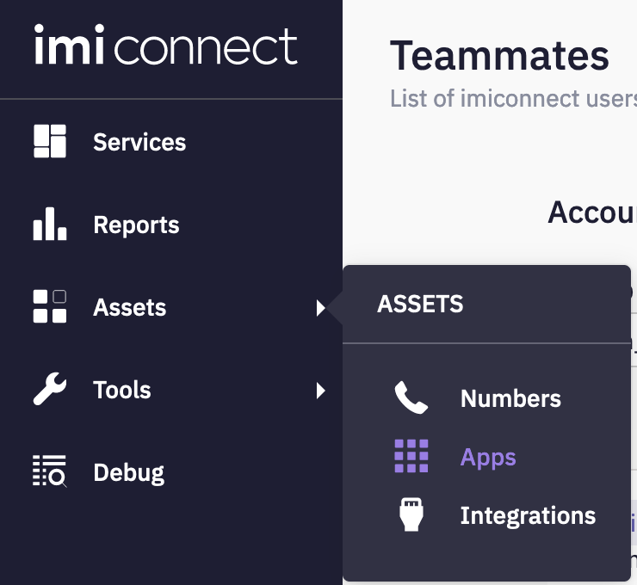
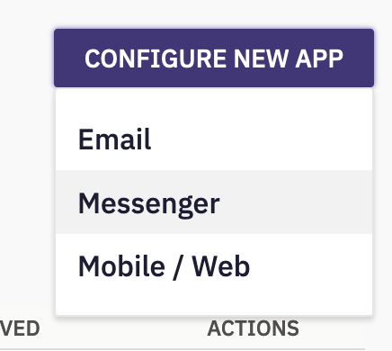
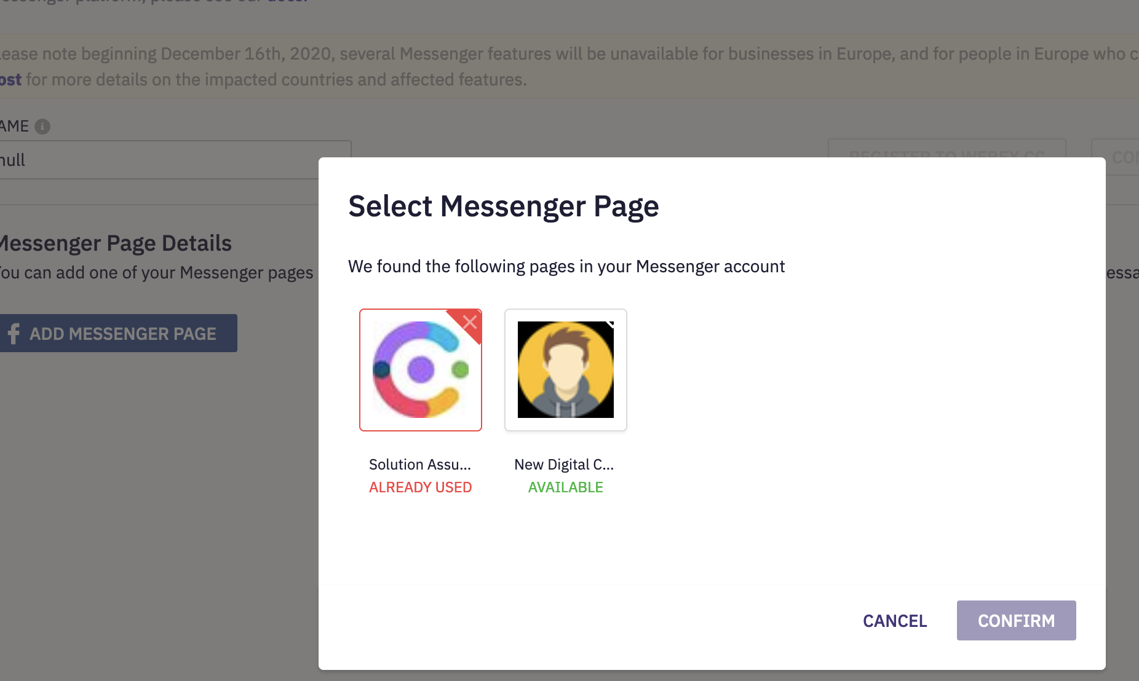
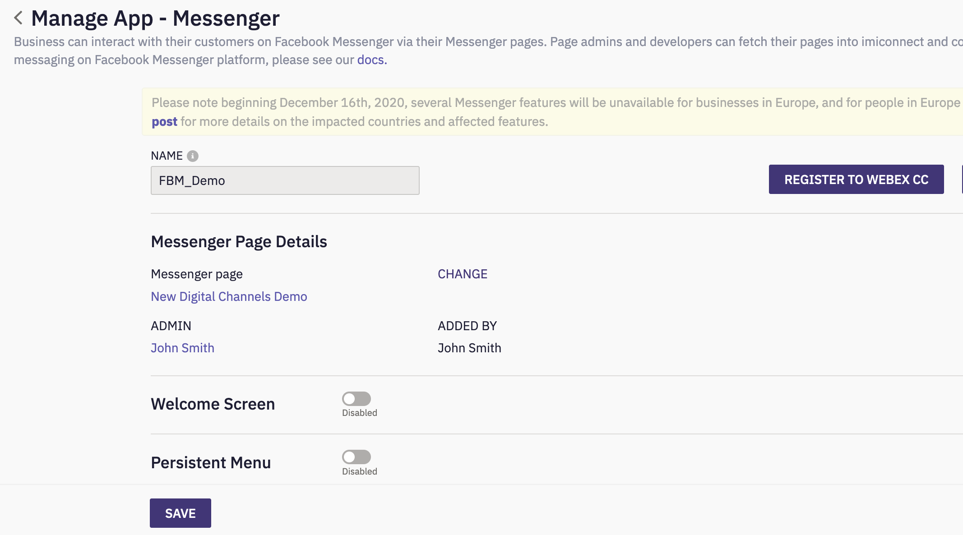
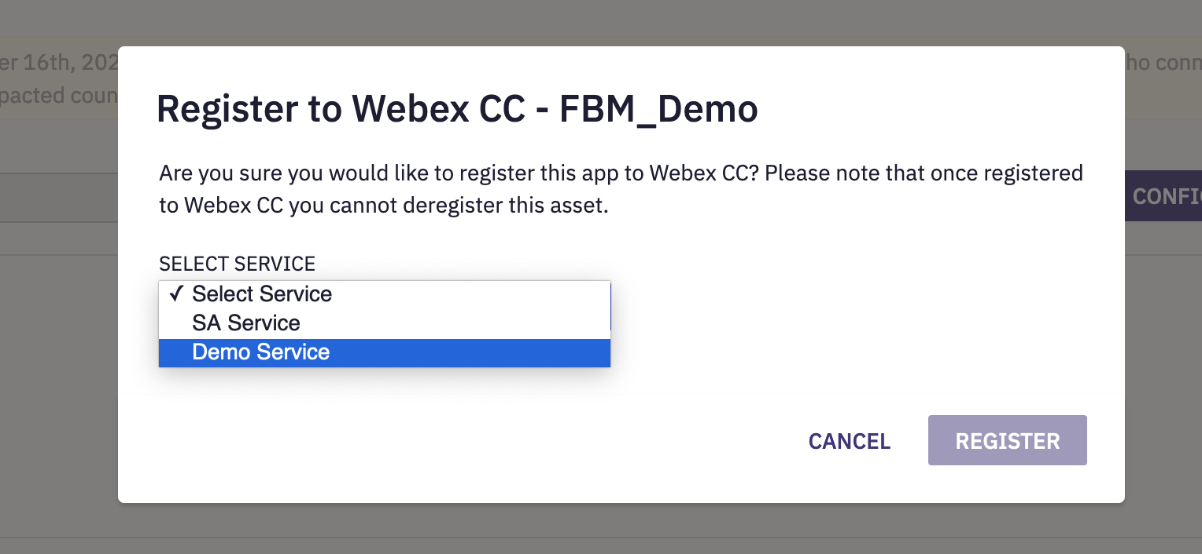
Facebook (FB) Asset Creation
Go to Assets > Apps
Go to Configure New App > Messenger
Click on Add Messenger Page
Authenticate with your FB account where you have a page already created
Select the respective page that you want to integrate
Provide the name and click ‘Save’ and ‘Register to WebExCC’ in the ‘Configure New App-Messenger’ window.
In the resulting window select the service and click ‘Register’

Slide 22
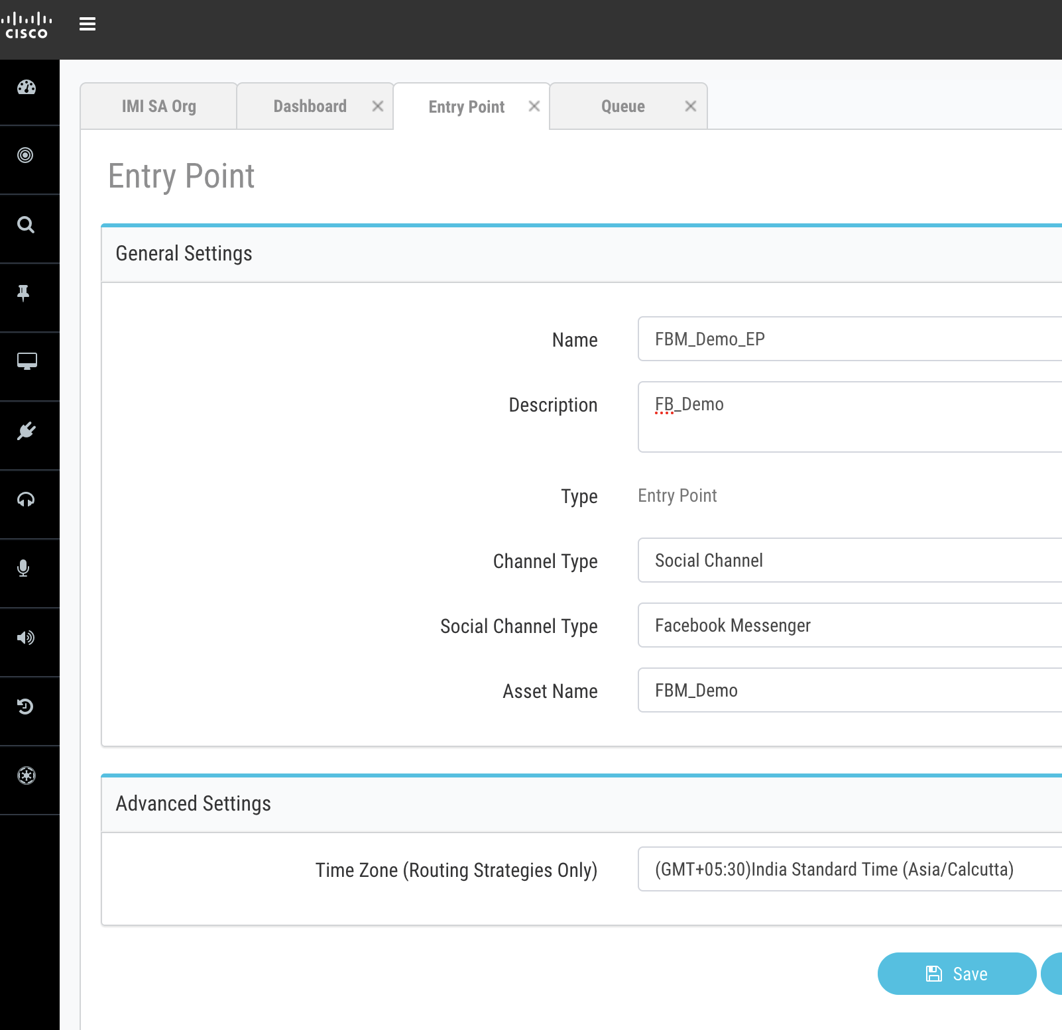
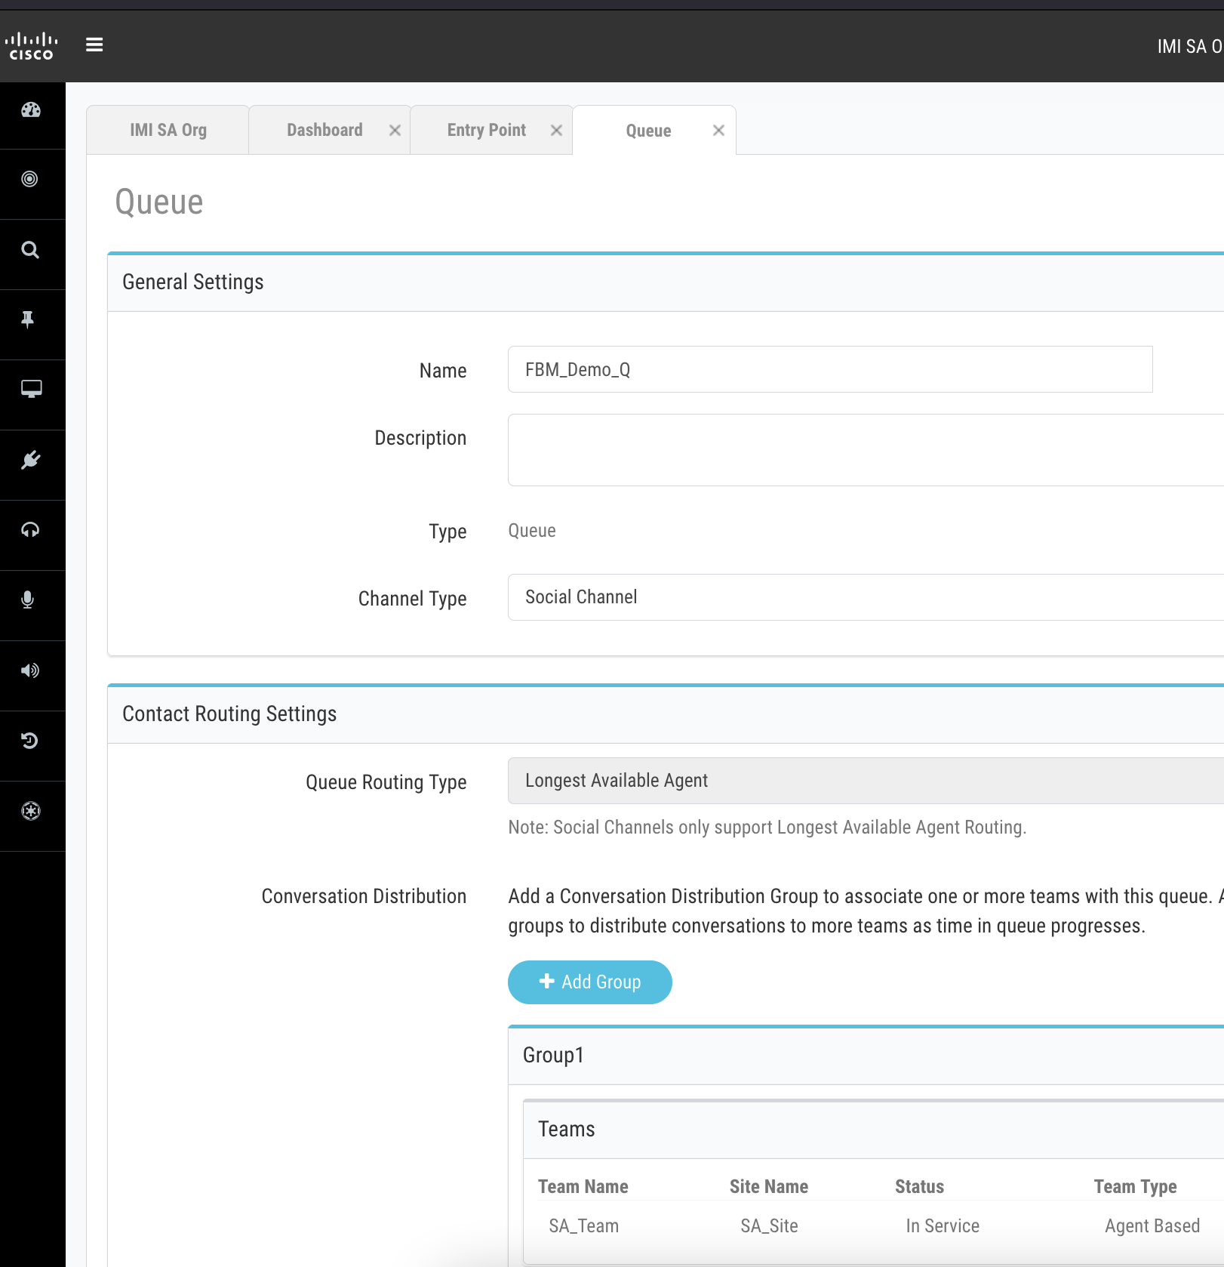
Entry Point and Queue Configuration
Login to WebexCC portal
Go to Provisioning > EP/Q > New Entry Point
Select ‘Channel Type’ as Social Channel
Select ‘Social Channel Type’ as ‘FBM’
In the dropdown, Select the asset created in previous step
Go to Provisioning > EP/Q > New Queue
Select ‘Channel Type’ as Social Channel
Conversation distribution > Add the team which agent is configured

Slide 23
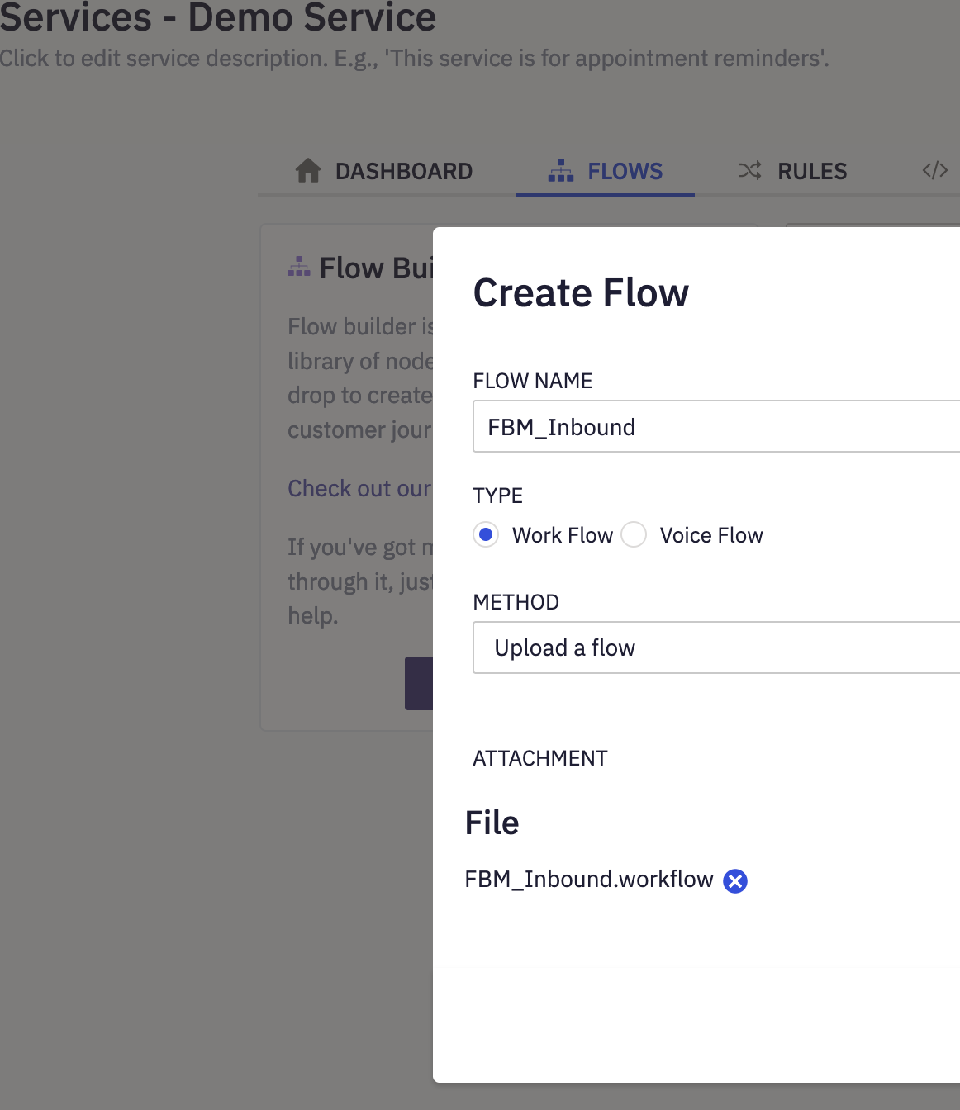
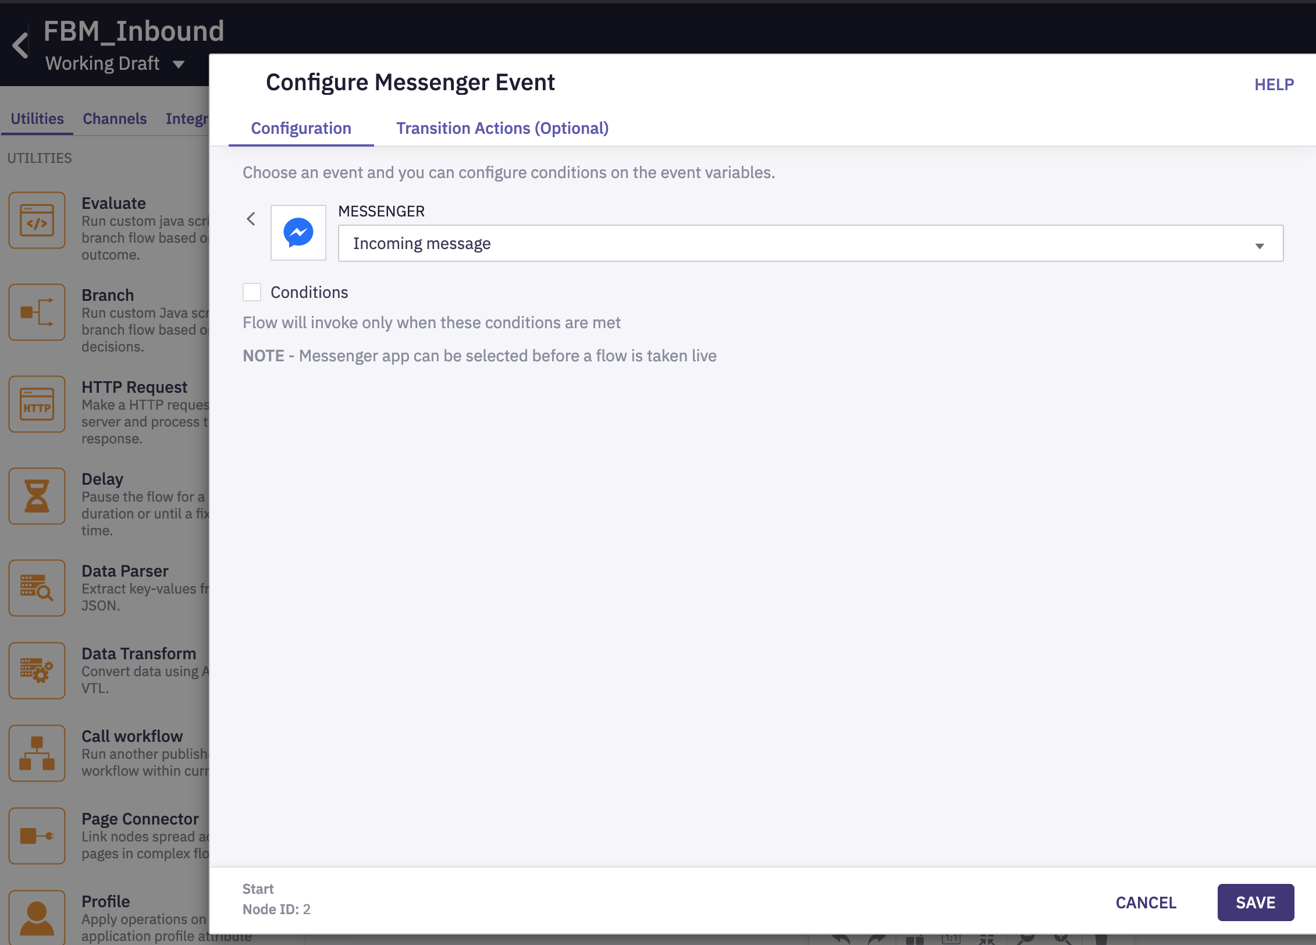
Facebook Messenger Inbound Workflow
Download the ‘FBM_Inbound’ workflow from this link
Go to Service (to which your asset is added) > Create Flow
Upload the ‘FBM_Inbound’ flow
Select ‘Incoming message’ as trigger
Click ‘Save’

Slide 24
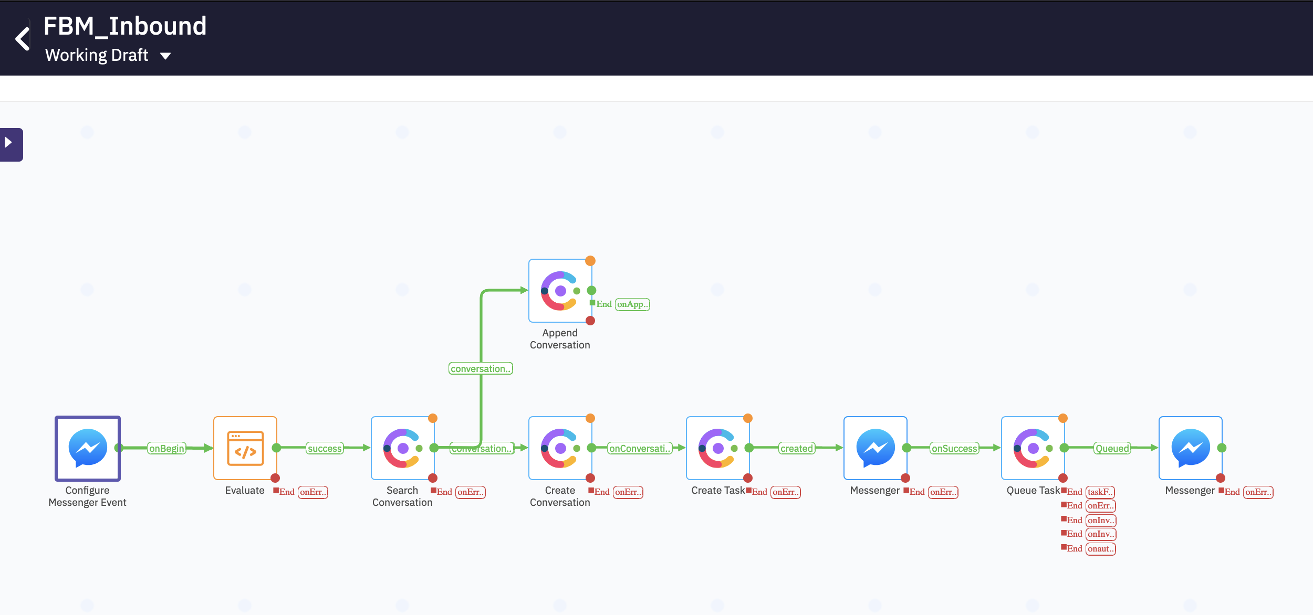
Detailed Contact Flow
Defines the Messenger trigger for this flow. It could be an incoming message or on link-click
For every new incoming message, this flow
Checks if there is an already existing IMI conversation
If yes, it will append this new message to the existing conversion
If no, it will create a new conversation
If a new conversion is created, a new task in WebexCC is also created
After successful task creation, the task is queued to a queue in WebexCC
Queue task node can be mapped to only 1 queue in WebexCC
2
1
3
4
- Add authorizations for each of the Engage and WebexCC nodes
- Sample video here which explains how to add authorizations (Do not add standard flows. Add the channel specific flows and add auth)
- Open & Update all nodes and ensure the configs are in place as per the documentation here
- Make sure to add your respective queue in the 'Queue Task' Node

Slide 25
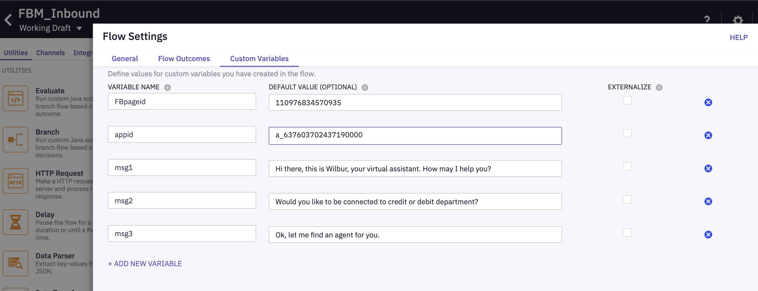
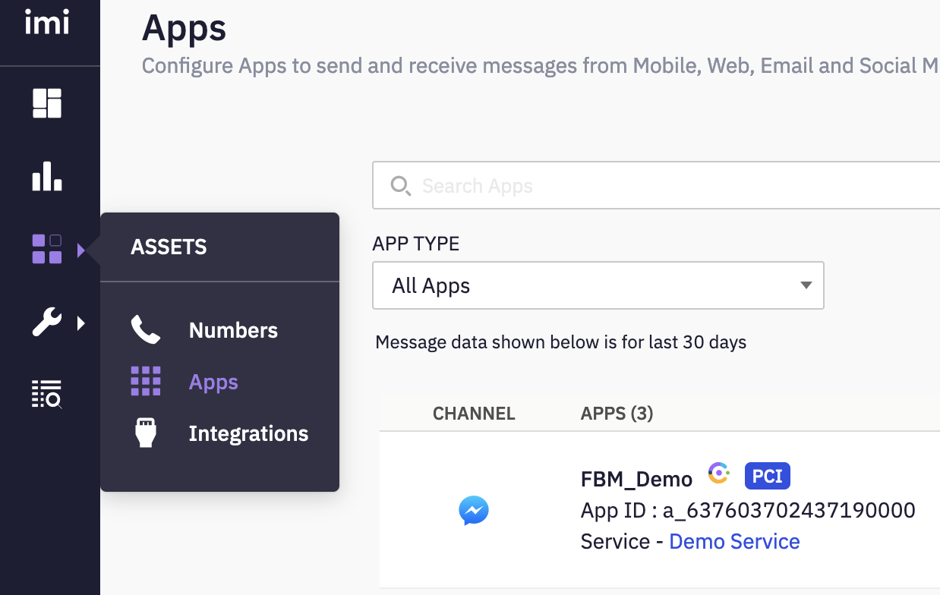
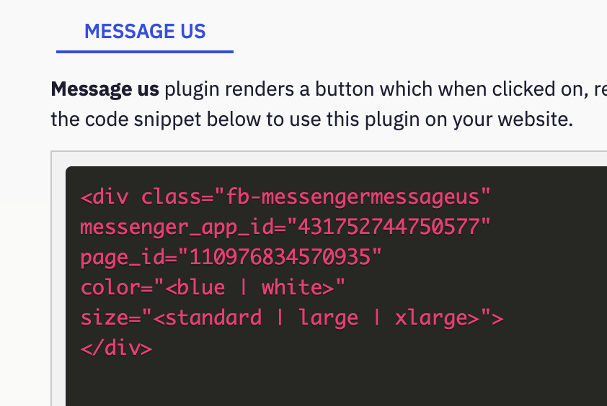
Update Flow Variables
Click on Flow ‘Settings’ (Top right wheel icon)
Update the ‘appid’ and ‘FBPageid’ variables
Replace the default value in the flow. If left to the default value, it will fail
Update respective values of your own FBM asset
Identify the below values for your own FBMessenger asset that you created
The FB ‘app_id’ and ‘page_id’ values are under the app configuration page

Slide 26
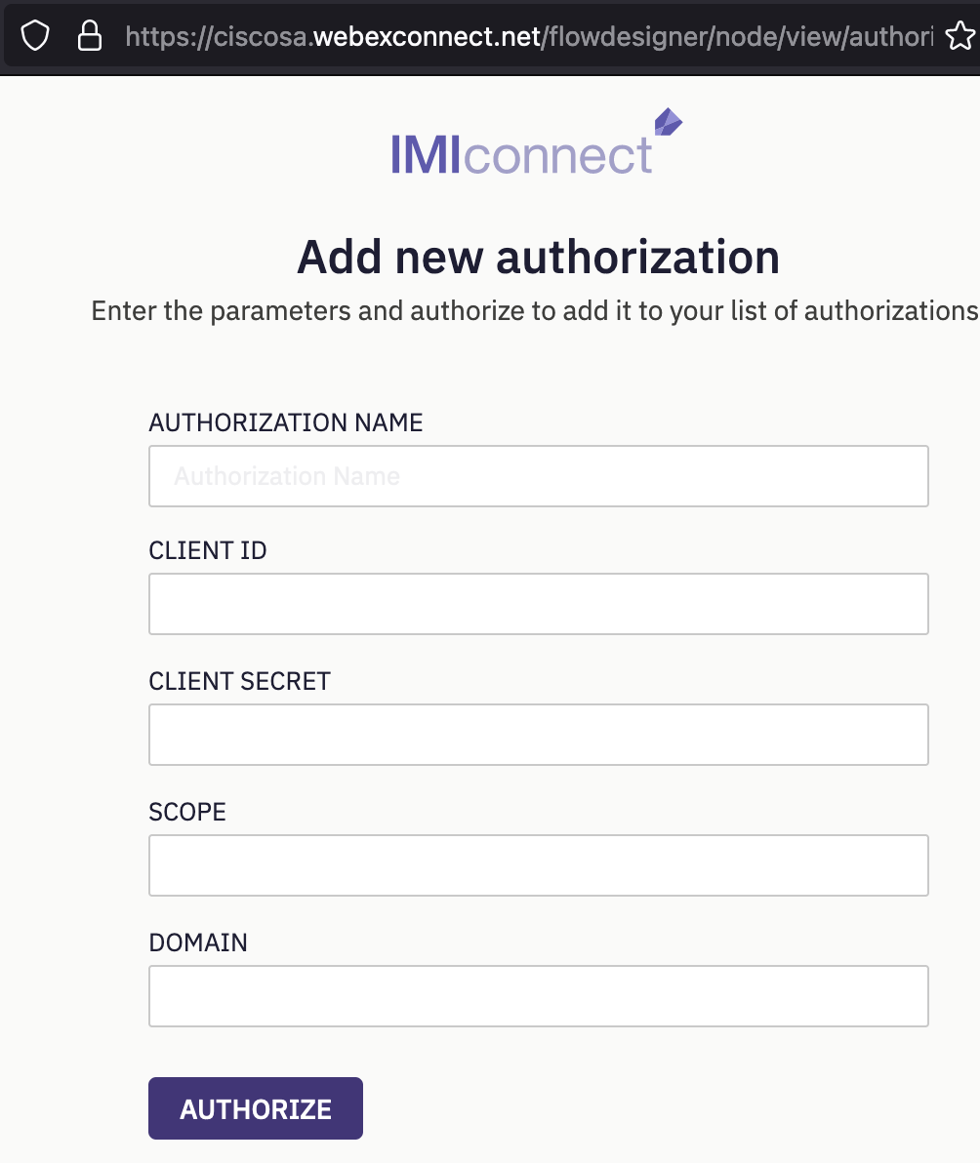
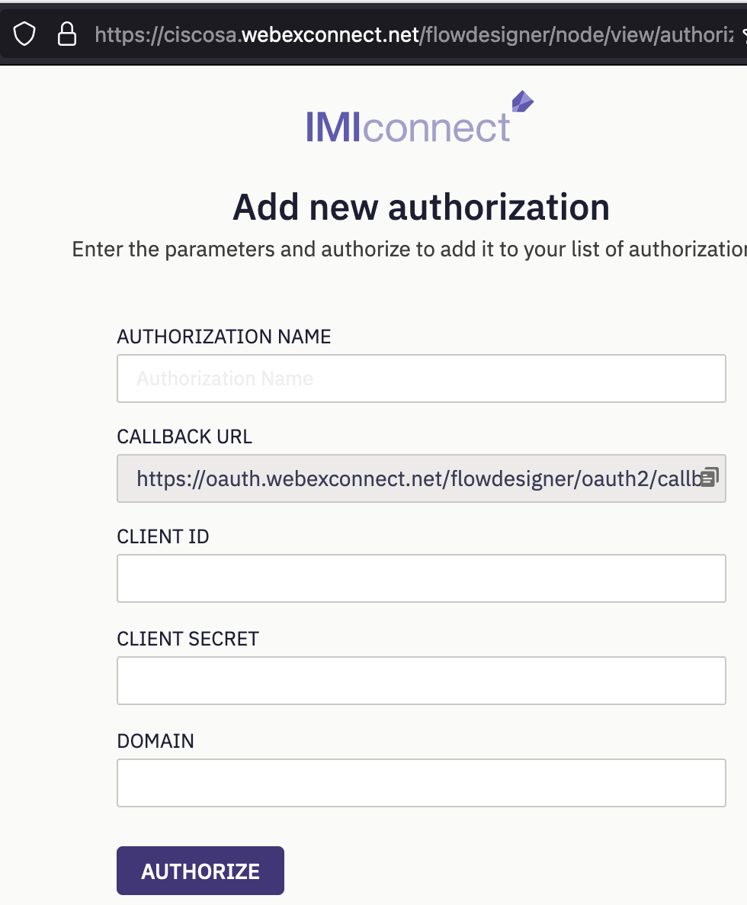
Create Authorizations
Engage Authorization
Engage Authorization
Client ID | ______your client ID____
Client Secret | ______your Client Secret_____
Domain | api-us-site-1.imiengage.io
WebexCC Authorization
While adding WebexCC Auth, login with the WebexCC Tenant admin creds.
WebexCC Authorization
The credentials above will change based on the IMI tenant and the WxCC environment.
The above need to be edited for your tenant
For Search Conversation, Append Conversation, Create conversion – add Engage Authorizations
For Create task, Queue Task – add Cisco WebexCC Authorizations

Slide 27
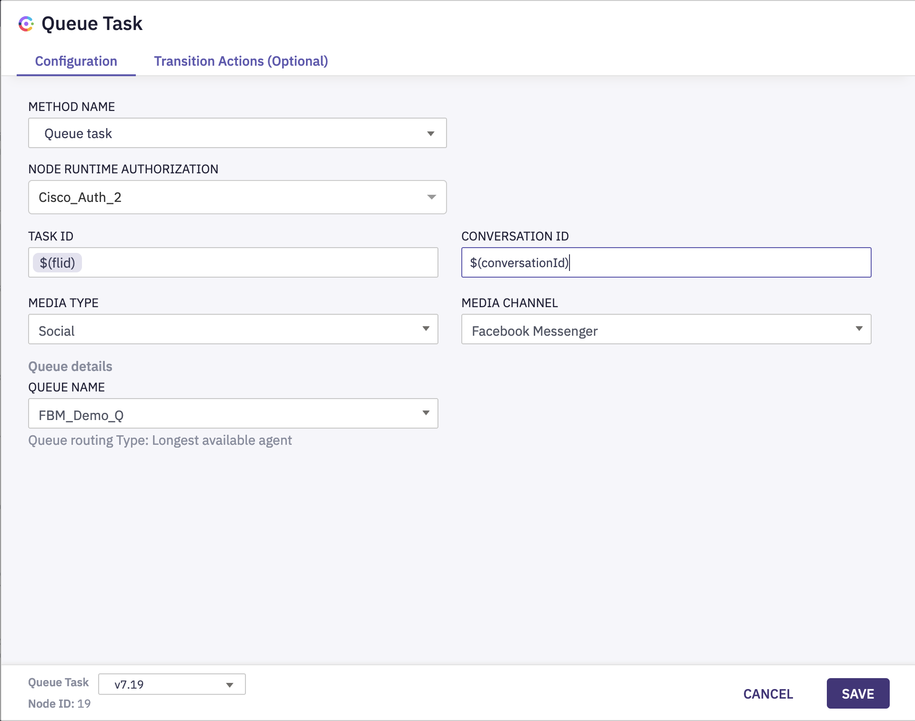
Queue Task Configuration
For each of the nodes in flow, add respective authorizations and save (auth is already added if you are using the SA tenant)
For ‘Queue Task’ node, add the authorization and then select the respective Queue

Slide 28
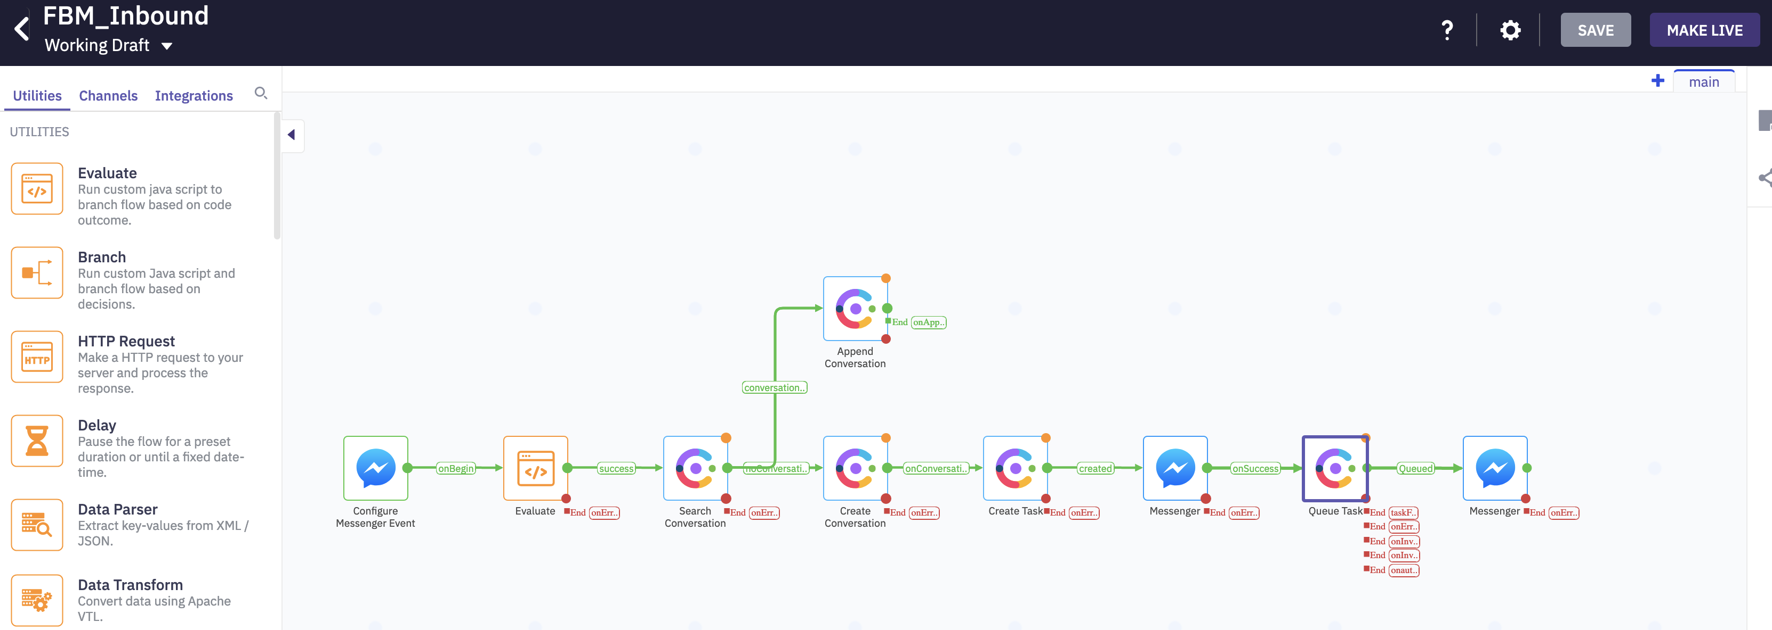
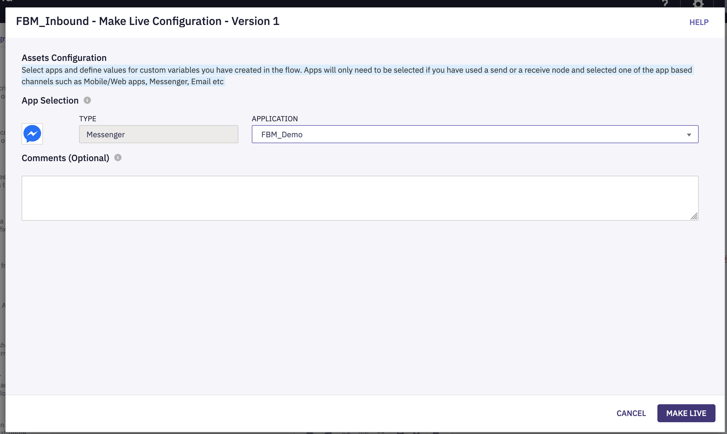
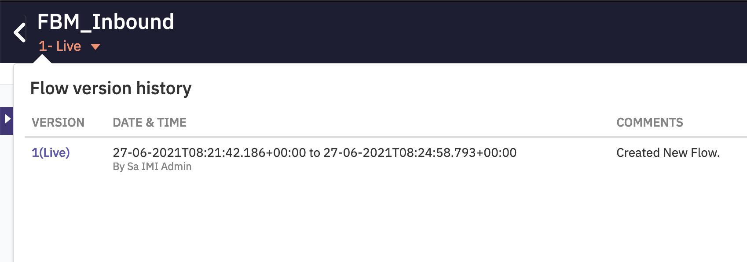
Make the Flow Live

Slide 29
Module 5
SMS Integration

Slide 30
Objective
You will be able configure and demo SMS channel integration with new digital channels
Pre-Requisites/Assumptions
Outcome
Pre-Req./Assumption | Comments
WebexCC Agents are created and associated with teams
SMS number is configured in the tenant | IMI team will assign a number
Service is created in IMI
All the standard flows are uploaded in the tenant
Outcome | Comments
Successfully integrate SMS channel
Initiate a SMS contact and route successfully to WebexCC Agent

Slide 31
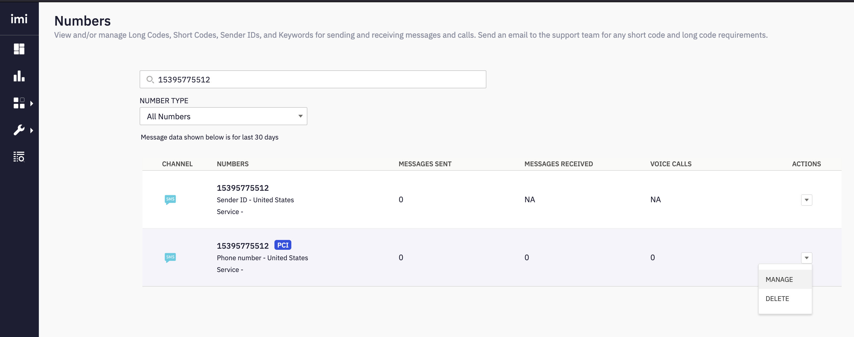
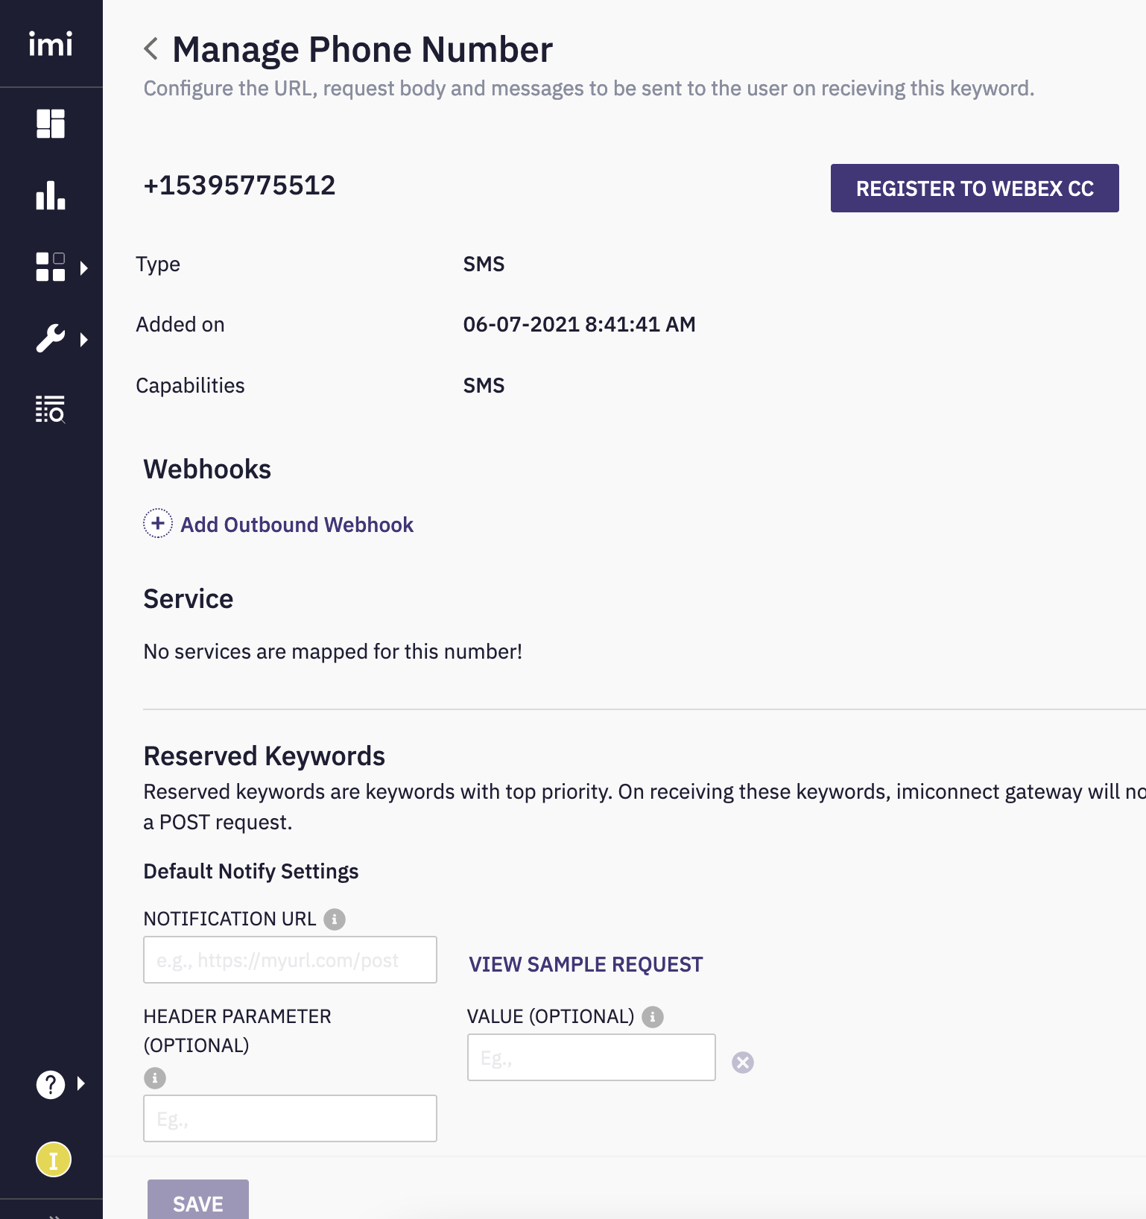
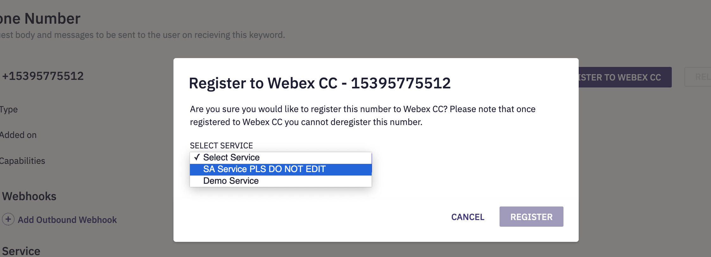
SMS Asset Creation
Login to Connect > Assets > Numbers > Actions Manage > Register to WebexCC
Select the service to which you want the asset to be registered

Slide 32
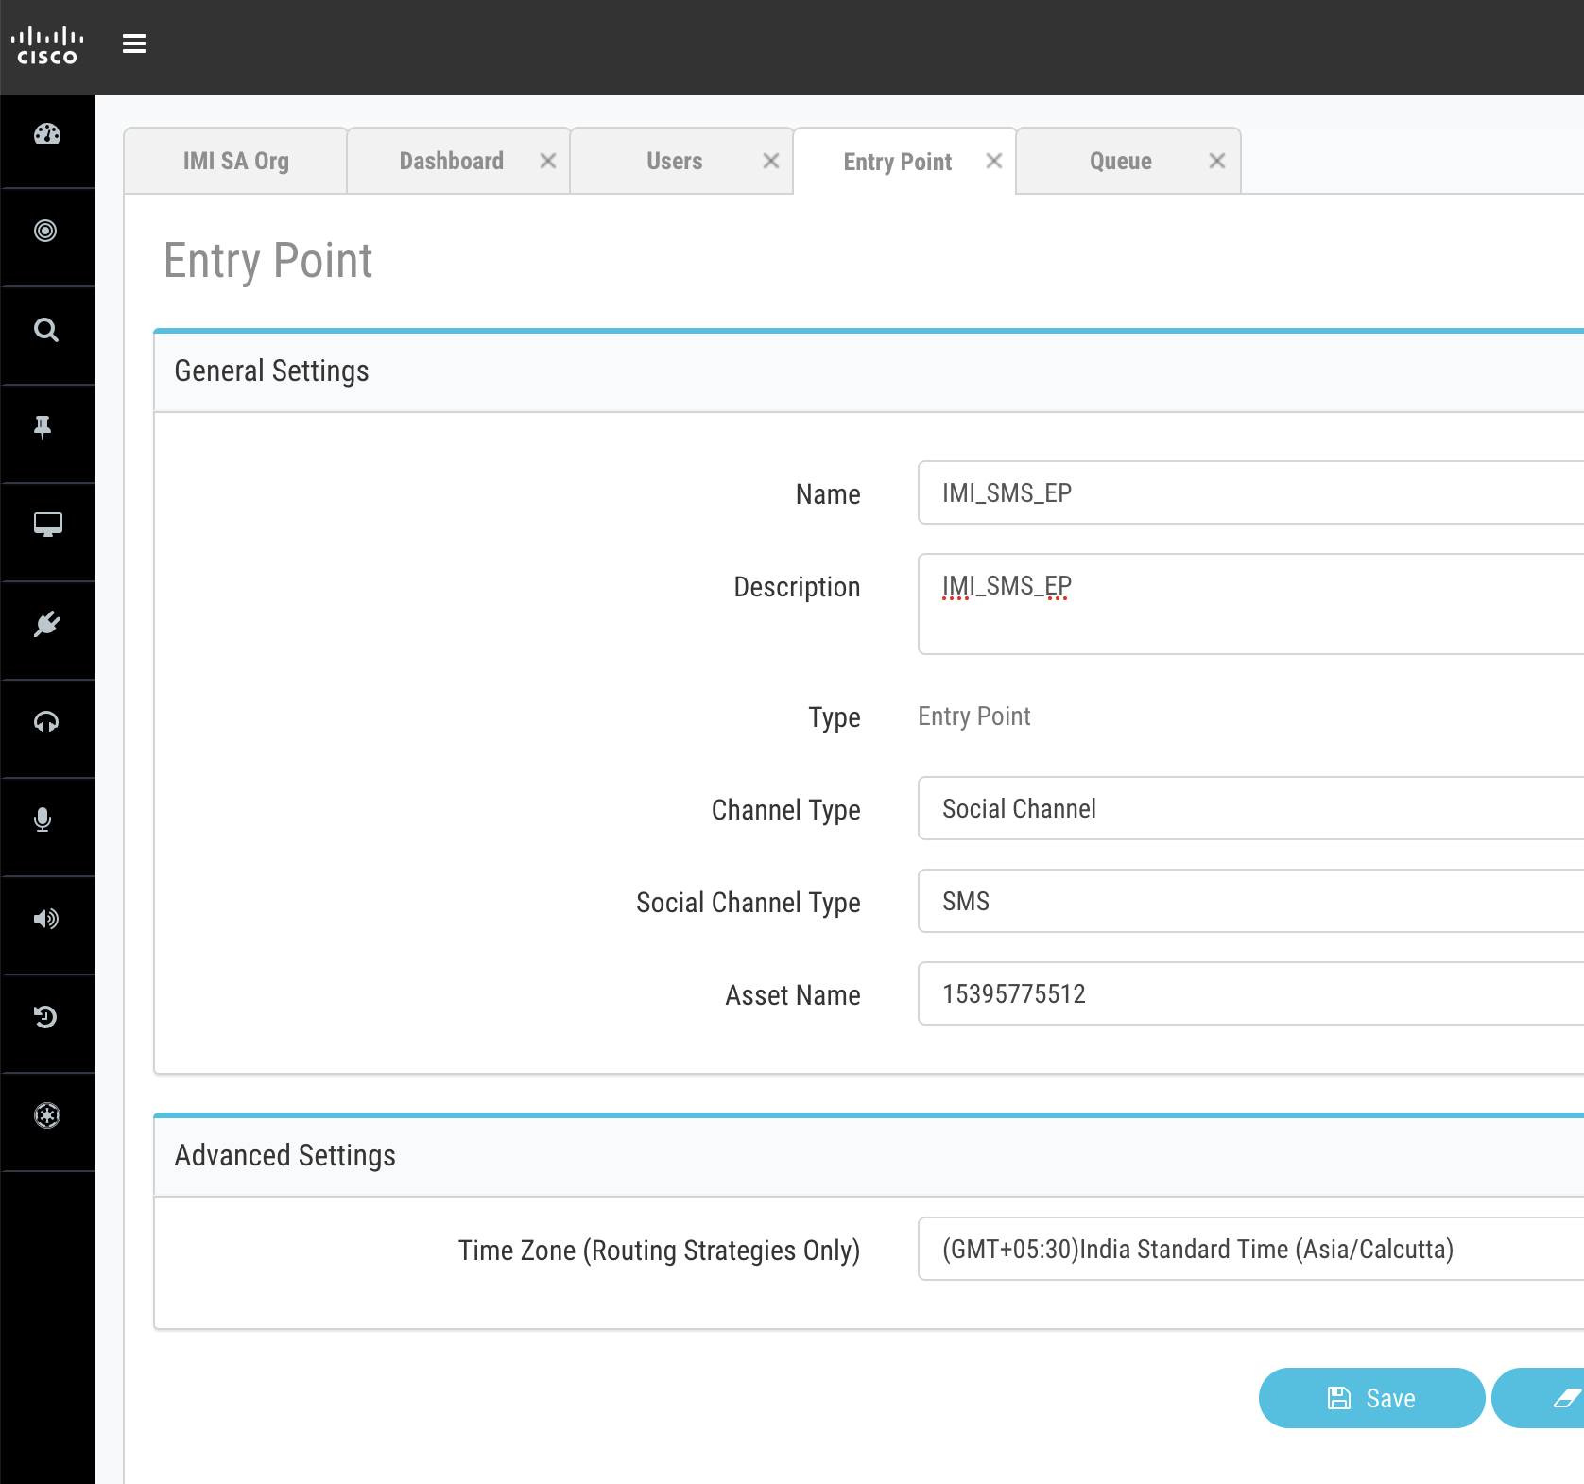
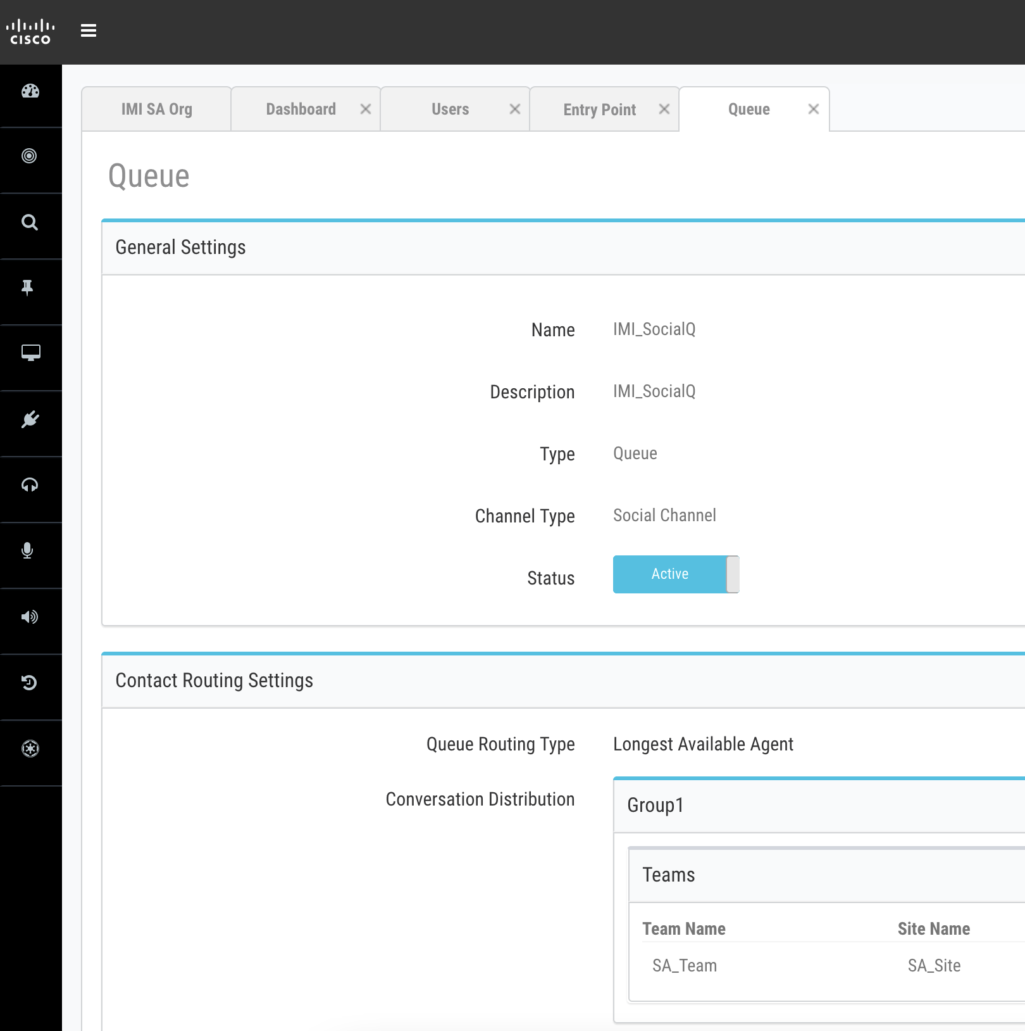
Entry Point and Queue Configuration
Login to WxCC portal
Go to Provisioning > EP/Q > New Entry Point
Select ‘Channel Type’ as Social Channel
Select ‘Social Channel Type’ as ‘SMS’
In the dropdown, Select the asset created in previous step.
Go to Provisioning > EP/Q > New Queue
Select ‘Channel Type’ as Social Channel
Conversation distribution > Add the team which agent is configured.

Slide 33
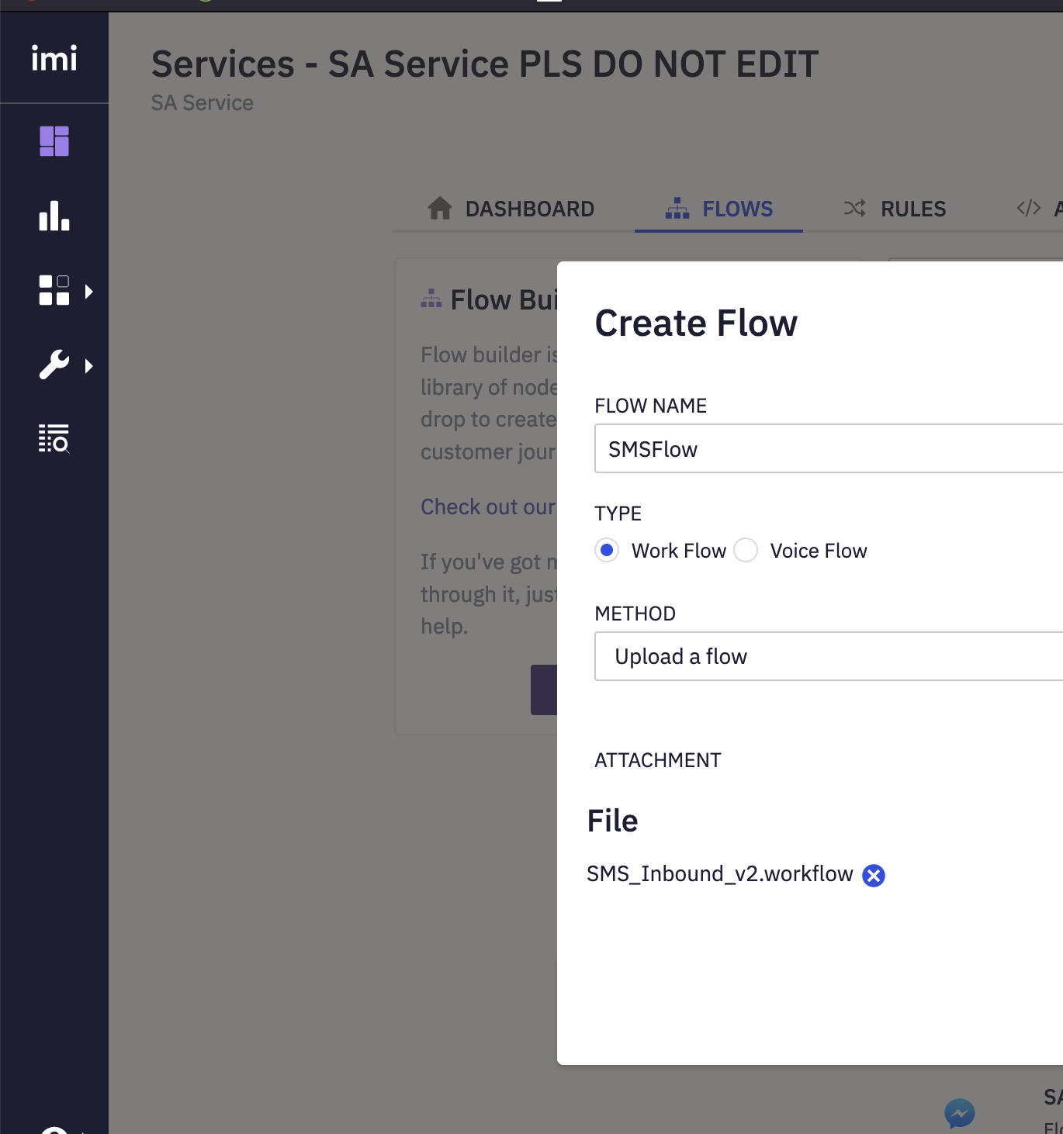
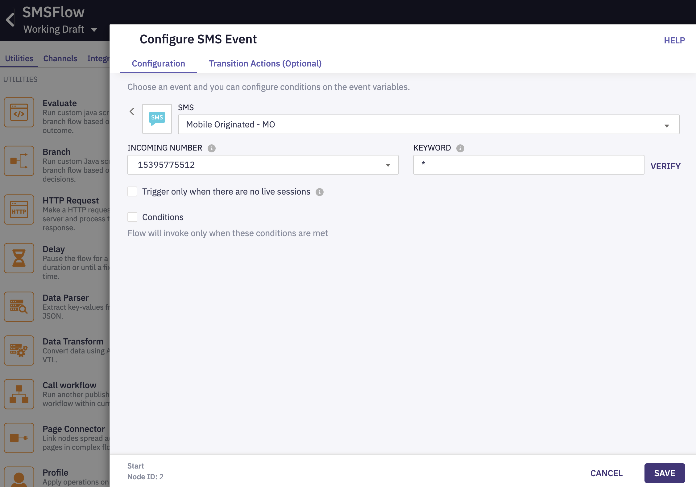
SMS Inbound Workflow
Select ‘Mobile Originate - MO’ as trigger
Select the Incoming Number
Click ‘Save’
Download the template flows from this link
Go to Service (to which your asset is added) > Create Flow
Upload the ‘SMS_Inbound’ flow

Slide 34
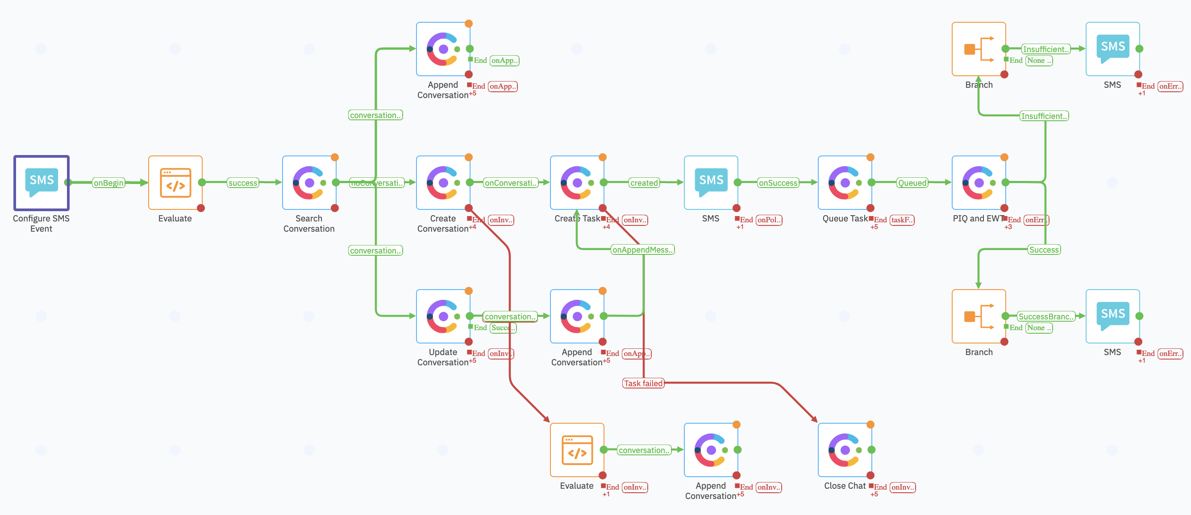
What is happening here?
Defines the messenger trigger for this flow. It could be an incoming message or on link-click
For every new incoming message, this flow
Checks if there is an already existing IMI conversation
If yes, it will append this new message to the existing conversion
If no, it will create a new conversation
If a new conversion is created, a new task in WebexCC is also created
After successful task creation, the task is queued to a queue in WebexCC
Queue task node can be mapped to only 1 queue in WebexCC
1
3
4
2
- Add authorizations for each of the Engage and WxCC nodes
- Sample video here which explains how to add authorizations. (do not add standard flows. Add the channel specific flows and add auth)
- Open & Update all nodes and ensure the configs are in place as per the documentation here
- Make sure to add your respective queue in the 'Queue Task' Node

Slide 35
Create Authorizations
Engage Authorization
Engage Authorization
Client ID | ______your client ID____
Client Secret | ______your Client Secret_____
Domain | api-us-site-1.imiengage.io
WebexCC Authorization
While adding WebexCC Auth, login with the WebexCC Tenant admin creds.
WebexCC Authorization
The credentials above will change based on the IMI tenant and the WxCC environment.
The above need to be edited for your tenant
For Search Conversation, Append Conversation, Create conversion – add Engage Authorizations
For Create task, Queue Task – add Cisco WebexCC Authorizations

Slide 36
Make the Flow Live

Slide 37
Module 6
Chat Integration

Slide 38
Objective:
You will be able configure and demo Live Chat channel integration with new digital channels
Pre-Requisites/Assumptions
Outcome
Pre-Req./Assumption | Comments
WebexCC agents are created and associated with teams
Test website to deploy the chat code is available
Service is created in IMI
All the standard flows are uploaded in the tenant
Outcome | Comments
Successfully integrate Chat Channel
Initiate a Chat contact and route successfully to WebexCC agent

Slide 39
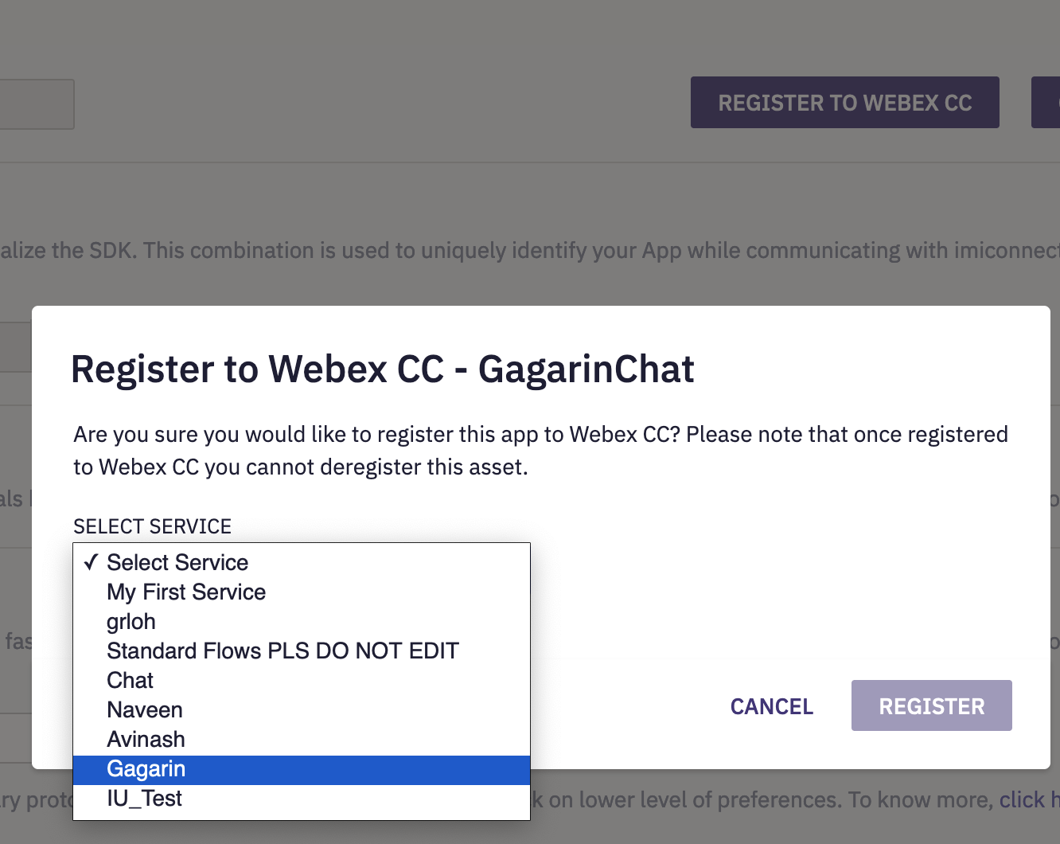
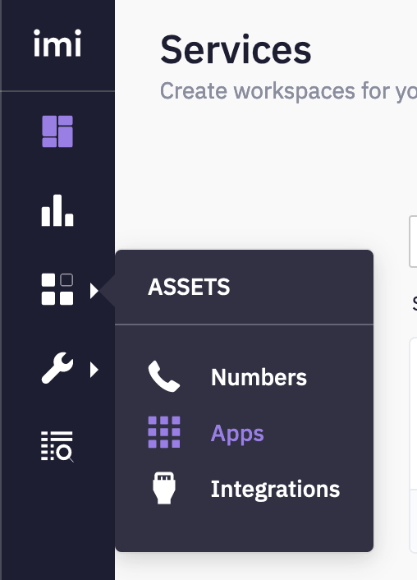
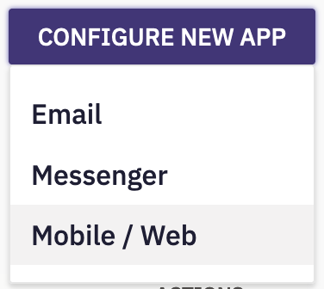
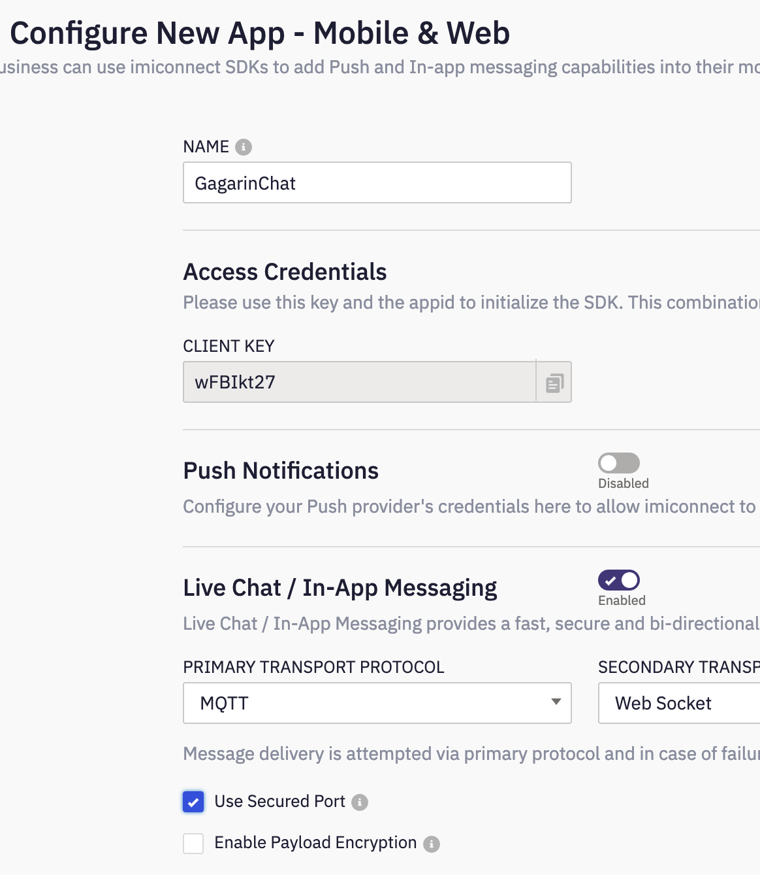
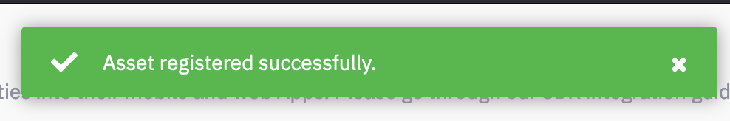
Chat asset creation
Login to Connect > Assets > Apps > Mobile/Web
Enable Live Chat / In-App Messaging. Select Primary & secondary protocol
Save
‘Register to Webex CC’ – Select the service when prompted > Register

Slide 40
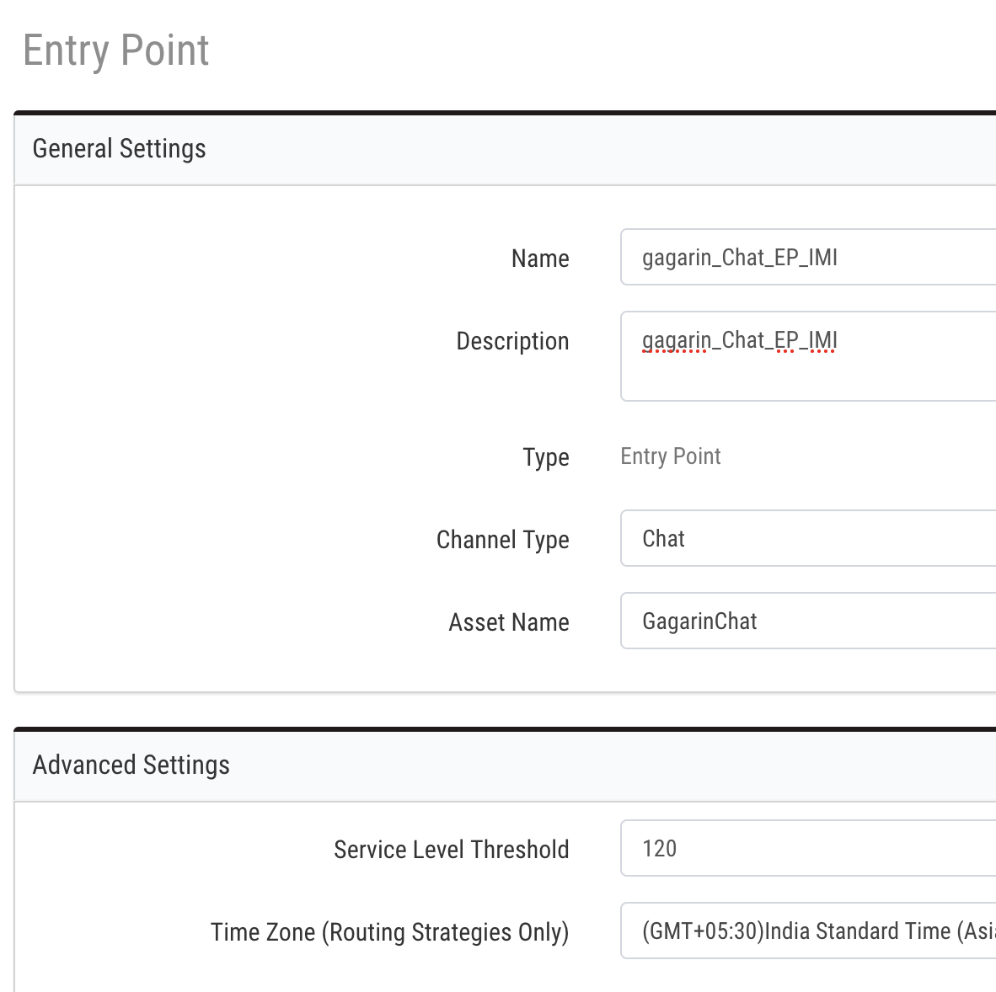
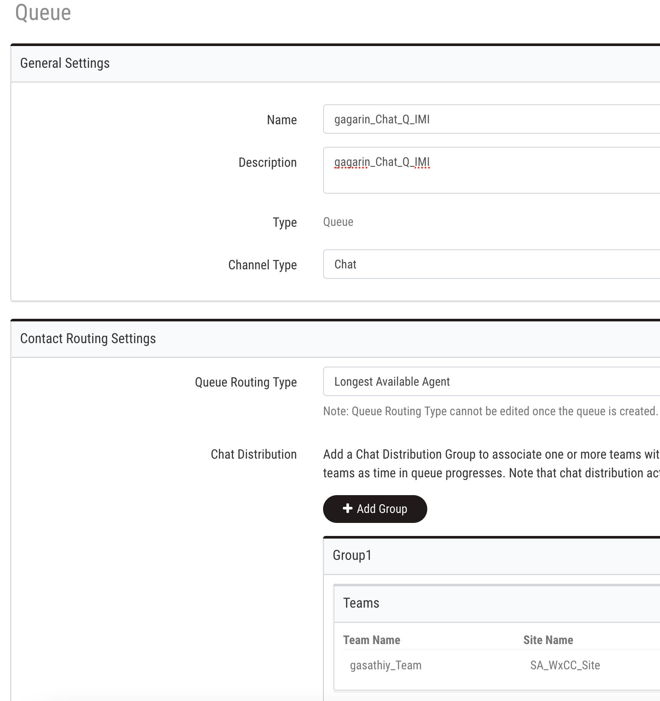
Entry Point and Queue Configuration
Login to WebexCC portal
Go to Provisioning > EP/Q > New Entry Point
Select ‘Channel Type’ as Chat
In the dropdown, Select the asset created in previous step.
Go to Provisioning > EP/Q > New Queue
Select ‘Channel Type’ as Chat
Conversation distribution > Add the team which agent is configured.

Slide 41
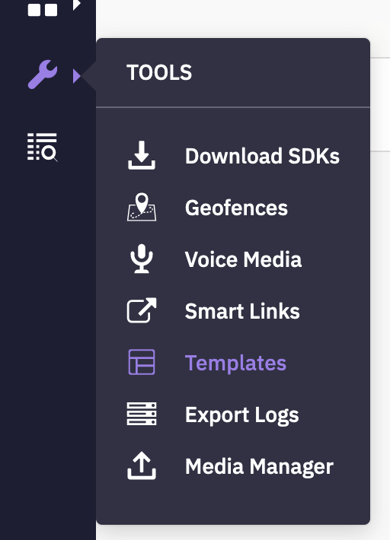
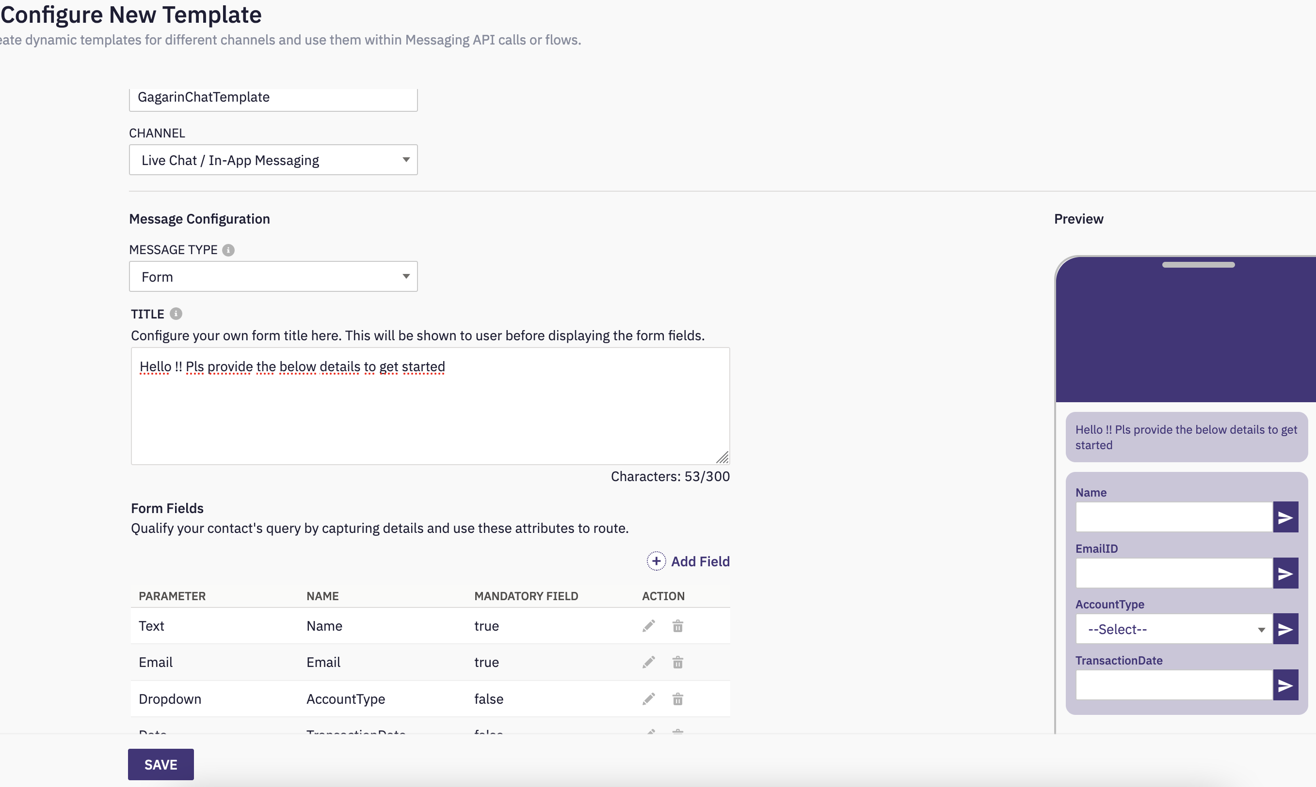

Chat Template Configuration
Connect > Tools > Templates > Add New Template
Select Channel as ‘Live Chat/in-app Messaging’
Message Type ‘Form’
Add Form fields as required
A preview of the template is available instantly

Slide 42



Add Website
Cross launch Engage from WebexCC portal
Go to Assets > Templates > Channel Assets
Select the ‘LiveChat’ Channel and edit your respective asset.
Go to Websites > Add Website

Slide 43





Chat Widget Configuration
Configure General, Appearance, Widget visibility Settings
Go back to Live Chat asset config page and go to ‘Installation’ to download the script

Slide 44

Add Chat Code to your website
A simple static webpage can be setup using free tools like,
https://glitch.com/
https://github.com/
https://www.netlify.com/

Slide 45


Chat Inbound Workflow
Download the template flows from this link
Go to Service (to which your asset is added) > Create Flow
Upload the ‘LiveChat_Inbound’ flow
Select ‘Incoming Message’ as trigger
Click ‘Save’

Slide 46

Add Authorizations & Update Queue
1. Add authorizations for each of the Engage and WebexCC nodes
2. Sample video here which explains how to add authorizations (do not add standard flows. Add the channel specific flows and add auth)
3. In the ‘pre-chat form’ & ‘Receive’ nodes, update the correct chat templates you configured
4. Open & Update all nodes and ensure the configs are in place as per the documentation here
5. Make sure to add your respective queue in the 'Queue Task' Node

Slide 47


Update Chat appID
Before publishing the flow, access the settings (top right) and go to Customer Variables
Update your respective appid for the LiveChat Asset

Slide 48


Customer/Agent Experience

Slide 49
Module 7
Email Integration

Slide 50
Objective:
You will be able configure and demo Email channel integration with new digital channels
Pre-Requisites/Assumptions
Outcome
Pre-Req./Assumption | Comments
WxCC agents are created and associated with teams
Email account created and has ability to forward
Service is created in IMI
All the standard flows are uploaded in the tenant
Outcome | Comments
Successfully integrate Email channel
Initiate a Email contact and route successfully to WxCC agent

Slide 51




Email Asset Creation
Login to Connect > Assets > Apps > Email
Add the Email account details, SMTP
Save and Test Connection. You should get a message about successful connection
‘Register to Webex CC’ – Select the service when prompted > Register

Slide 52




Email Asset Creation
Copy the ‘Forwarding Address’ from the previous step and add it in your email account settings (in this example Gmail is used and added under Settings > ‘Forwarding & POP/IMAP’ section. Confirmation code will be requested in Gmail
In Connect > Tools > Export Logs > Inbound Logs > Select your respective Email Asset > Incoming Email > Today
In the exported logs (csv format) look for ‘Subject’ column and identify the number ( in the above example it is 79314091)
Add this number as the confirmation code in Gmail

Slide 53


Entry Point and Queue Configuration
Login to WebexCC portal
Go to Provisioning > EP/Q > New Entry Point
Select ‘Channel Type’ as Email
In the dropdown, Select the asset created in previous step
Go to Provisioning > EP/Q > New Queue
Select ‘Channel Type’ as Email
Conversation distribution > Add the team which agent is configured

Slide 54

Email Inbound Workflow
Download the template flows from this link
Go to Service (to which your asset is added) > Create Flow
Upload the ‘Email_Inbound’ flow
Select ‘Incoming Message’ as trigger
Click ‘Save’

Slide 55

Add Authorizations & Update Queue
- Add authorizations for each of the Enage and WebexCC nodes
- Sample video here which explains how to add authorizations. (do not add standard flows. Add the channel specific flows and add auth)
- Open & Update all nodes and ensure the configs are in place as per the documentation here
- Make sure to add your respective queue in the 'Queue Task' Node

Slide 56
Module 8
Configuring Templates (pre-defined responses)

Slide 57
Objective
You will be able configure pre-defined templates for the digital channels
Pre-Requisites
Outcome
Pre-Req/Assumption
WxCC agents are able to accept contacts successfully
Outcome
Successfully create templates and use them in agent desktop.

Slide 58



Add Template Group
Cross launch Engage from WebexCC portal
Go to Assets > Templates > Add a Template Group
Select the newly created template group and ‘Add Template’

Slide 59

Add Templates
You can create a common template applicable for all channels (or)
You can create channel specific templates
In the Template text, type ‘@@’ to get a list of available variable for use

Slide 60


Desktop Experience

Slide 61
Module 9
Workflow Debugging

Slide 62

Accessing the Debug Menu
Access the Flow > Click on the ‘Debug’ option > ‘Decrypt Logs > Select the appropriate ‘Transaction ID’ to open the logs
You can look at the last Node status to identify the outcome of a particular transaction

Slide 63

Select a Timeframe

Slide 64

Drilldown of Transaction Logs
Look for the node with an ‘error’ outcome and click on that node to get additional details of the error
Each node will have the API request/response details for further debugging
On Click of a node (for example ‘Create Task’), the respective node will be highlighted in the flow canvas

Slide 65


Share/Export Workflows
Read Only access to any flow can be shared with support teams if required
Also, the flows can be exported from a tenant and used in a different tenant to replicate any problem (respective authorizations, asset IDs to be updated)

